Slide 1
I LOVE FREE
GREAT RESOURCES FOR
The CLASSROOM
Jan Coley
Jefferson County Schools
STEM/Science Coordinator
jcoley@jcboe.net

Slide 2
COLLABORATION
On the Web
LiveBinders
example
Padlet (formerly Wallwisher) – easy to use
Popplet
Voicethread
Edmoto
OneDrive
Free tools (Microsoft)
Google Docs
Today’s meet

Slide 3
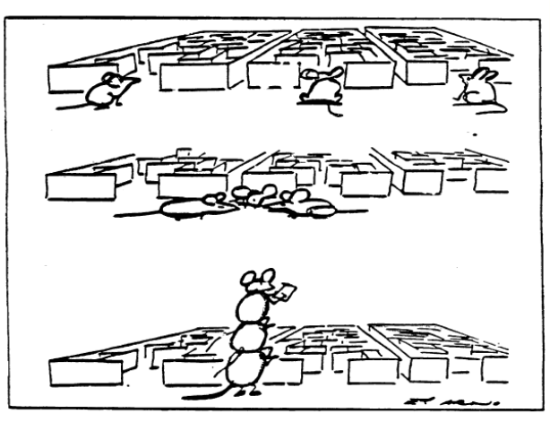
http://www.iatd.net/Main%20website/Resources/documents/CCSS_Assessments_Presentation_01_10_2011teachers.pdf

Slide 4
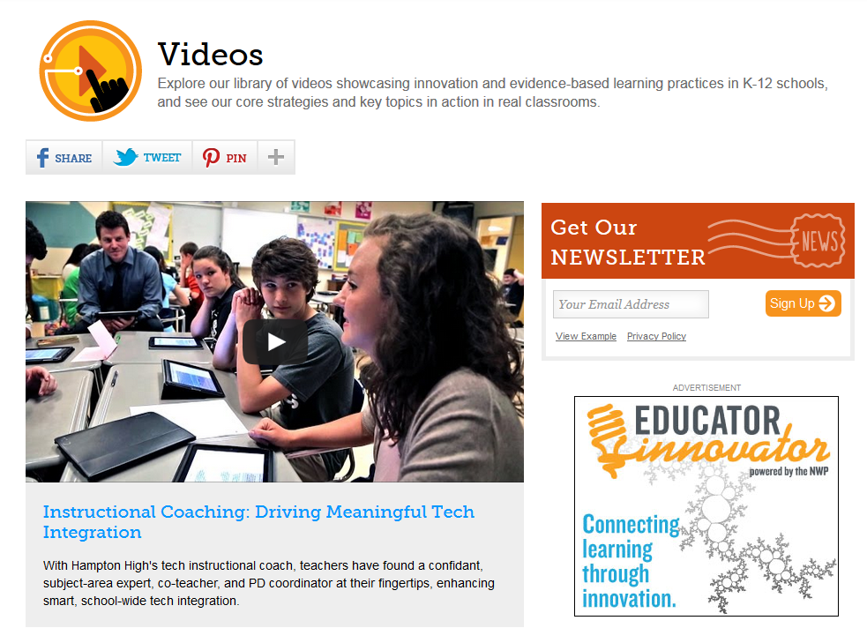
Edutopia videos

Slide 5
Buck Institute

Slide 6
iTunes U
http://www.apple.com/education/guidedtours/itunesu.html
Part of the iTunes store
Educational, audio, and video content
Most popular downloads
Contents categories
By University

Slide 7
Tennessee Opportunity Programs, Inc. (TOPS) is a private non-profit agency chartered in 1973 in the State of Tennessee. We are recognized by the Internal Revenue Service as a 501(c)(3) tax exempt organization.

Slide 8
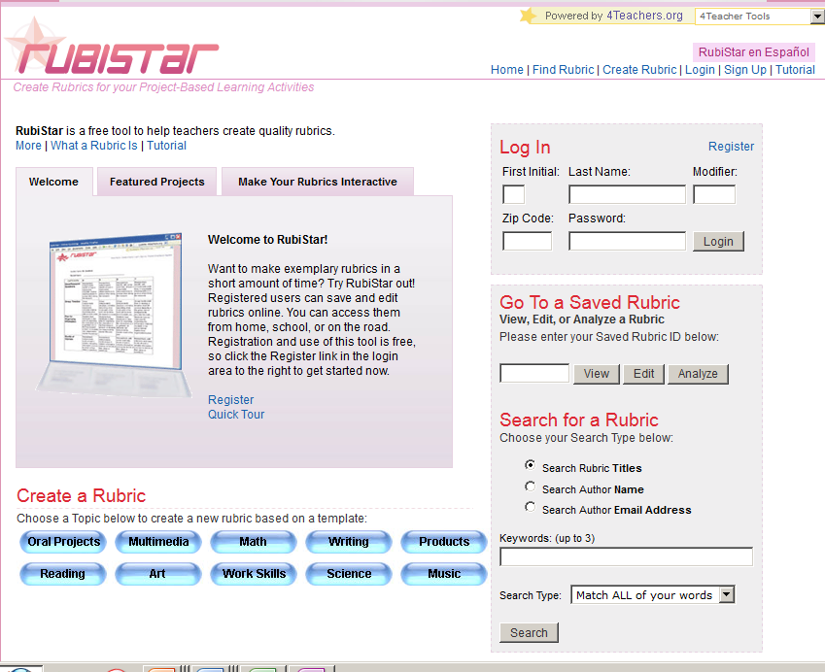
Rubistar
Assessment
Tools

Slide 9
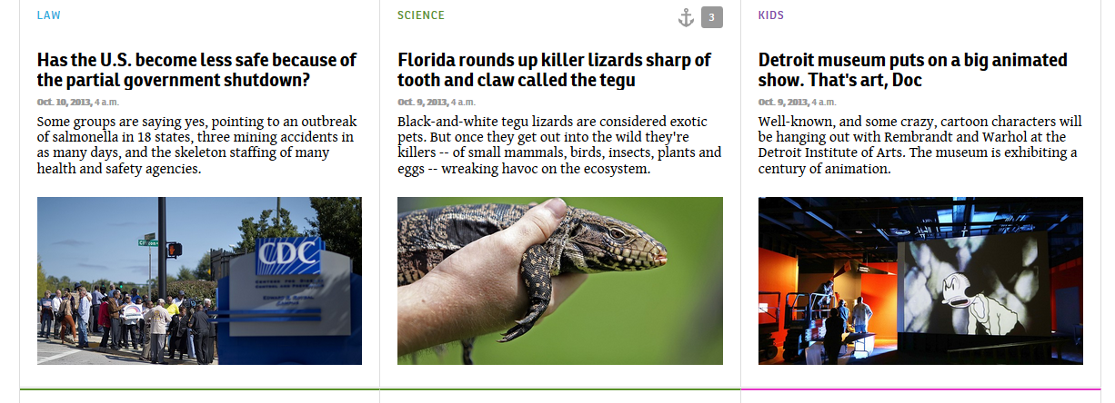
Newsela.com

Slide 10
Today’s Meet https://todaysmeet.com/CN_ScienceMethods

Slide 11
Edutopia videos

Slide 12
Buck Institute

Slide 13
Strategies
Use of Video
Animoto
Windows Live Movie Maker
PowerPoint 2013

Slide 14
Strategies
SWAY
Create and share interactive content in minutes!

Slide 15
Google Forms for Educators
Getting to Know You
Snowflake Quiz
Parent Teacher Conferences
Grading with Flubaroo

Slide 16
Periodic Table of Videos

Slide 17
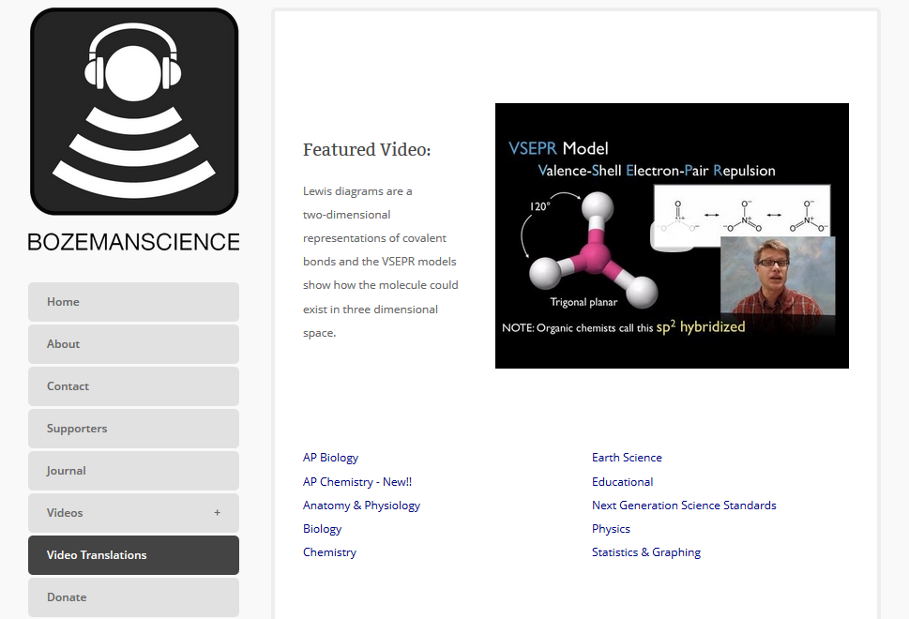
Strategies
Bozeman Science

Slide 18
COLLABORATION
APPs
Join me
Whiteboard free
Whiteboard Lite:
Collaborative Drawing
Edmoto

Slide 19
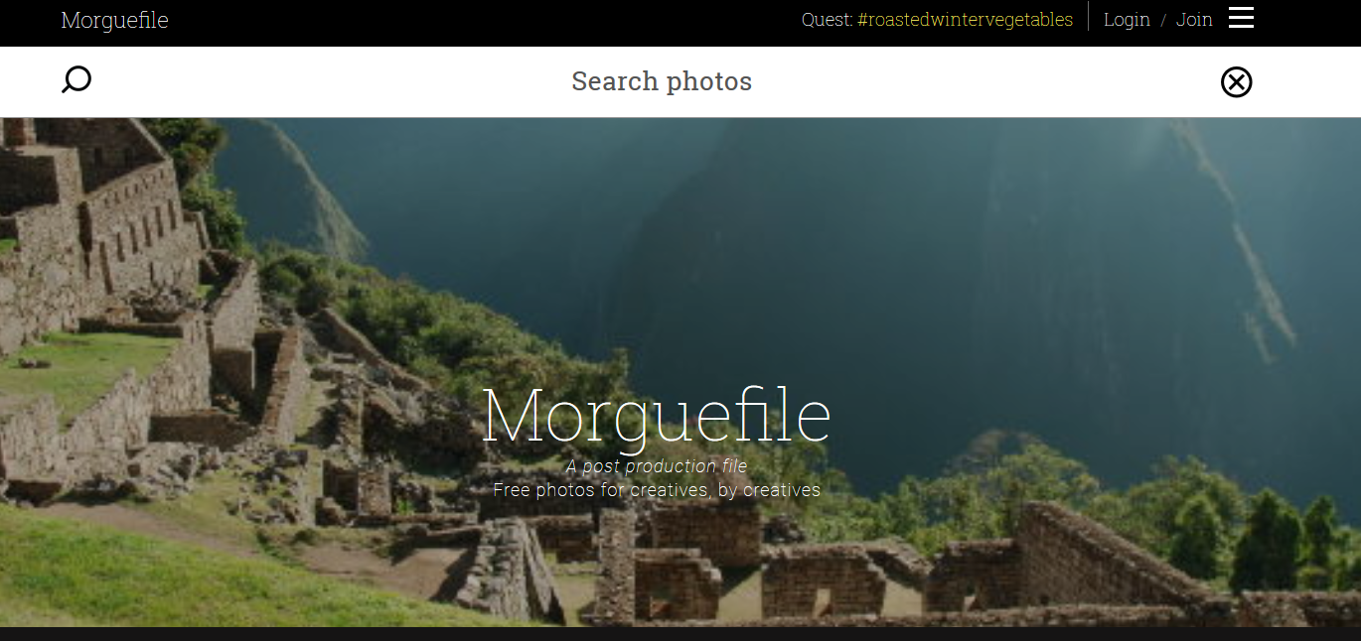
MorgueFile

Slide 20
Edulastic

Slide 21
Strategies
Cornell Notes

Slide 22
Strategies
AutoCollage
Photo collages celebrate important events and themes in our lives. Pick a folder, press a button, and in a few minutes AutoCollage presents you with a unique memento to print, email, or include in a digital project.

Slide 23
Teaching Channel
The Teaching Channel - Videos, common Core Resources and Lesson Plans
A Go To Toolbox for Teachers

Slide 24
mathematics add-in
Works with Microsoft Word 2010, Microsoft Office Word 2007, and Microsoft OneNote 2010. With this add-in, you insert an advanced math problem (from algebra to calculus, physics, or statistics) and then click to simplify complex expressions or to solve.

Slide 25
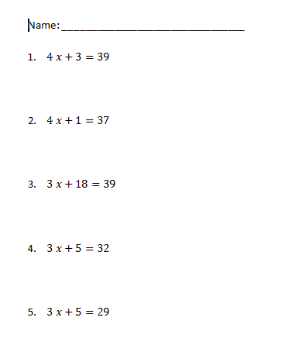
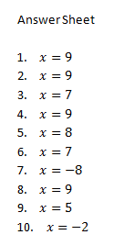
Math Worksheet Generator

Slide 26
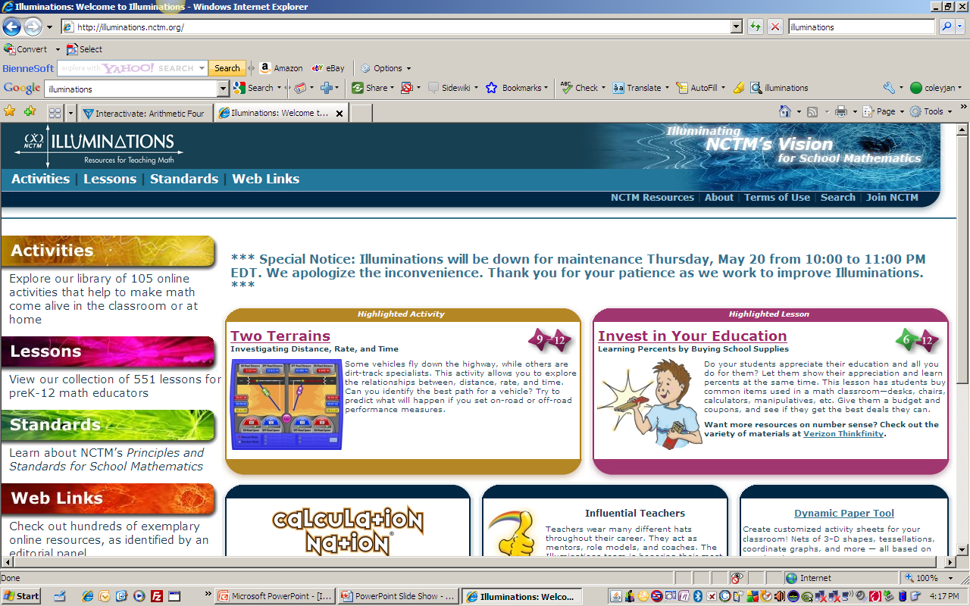
Illuminations

Slide 27
Interactivate
Grades
3 - 12

Slide 28
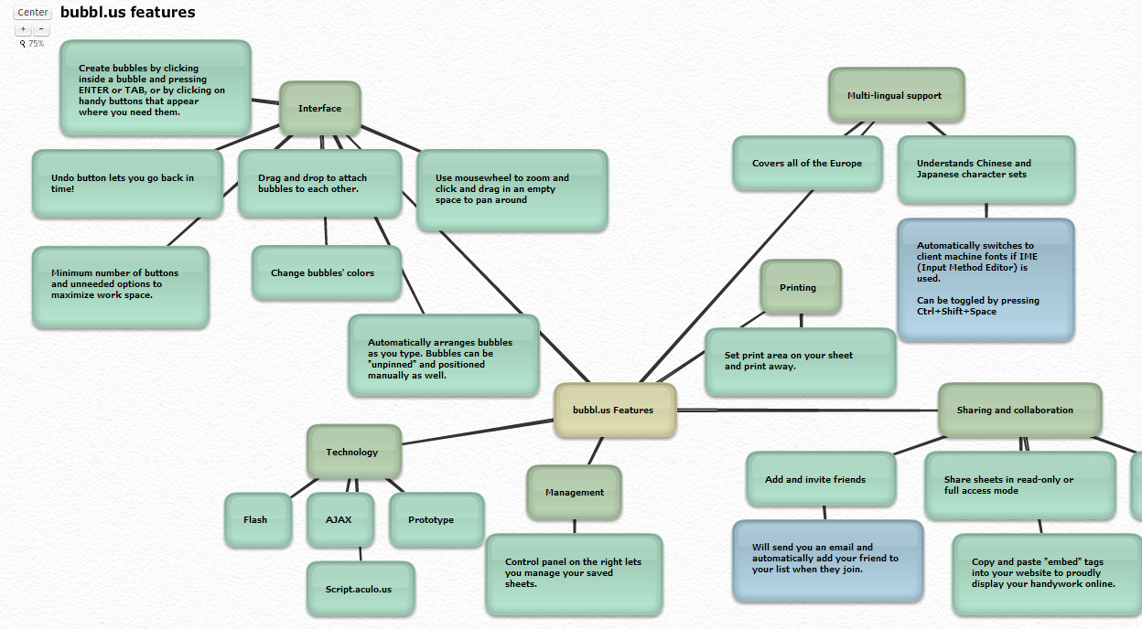

Slide 29
RESOURCES TO SUPPLEMENT AND ENRICH LESSONS
NBC LEARN
Science 360

Slide 30
Cool Tools
Quizlet
Tennessee Electronic Library
Library of Congress
iTunes U

Slide 31
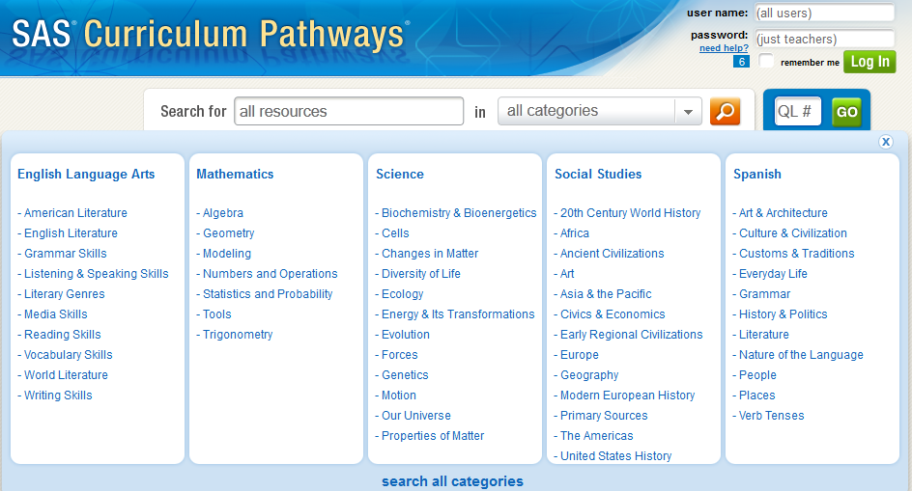
Content Resources
Curriculum Pathways

Slide 32
Content Resources
Treasures On-line – McGraw-Hill Companies
Utah Education Network – K-12 student center
K-2 Student Interactives
3-6 Student Interactives
7-12 Student Interactives
Making Common Core Uncommonly Exciting
Select the ISTE 2012 presentation

Slide 33
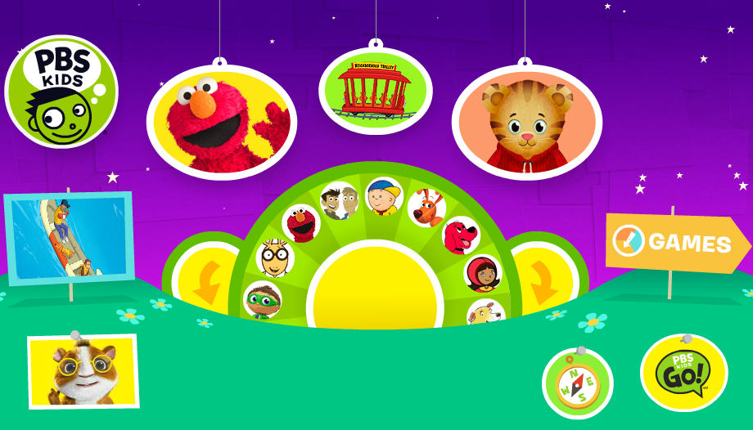
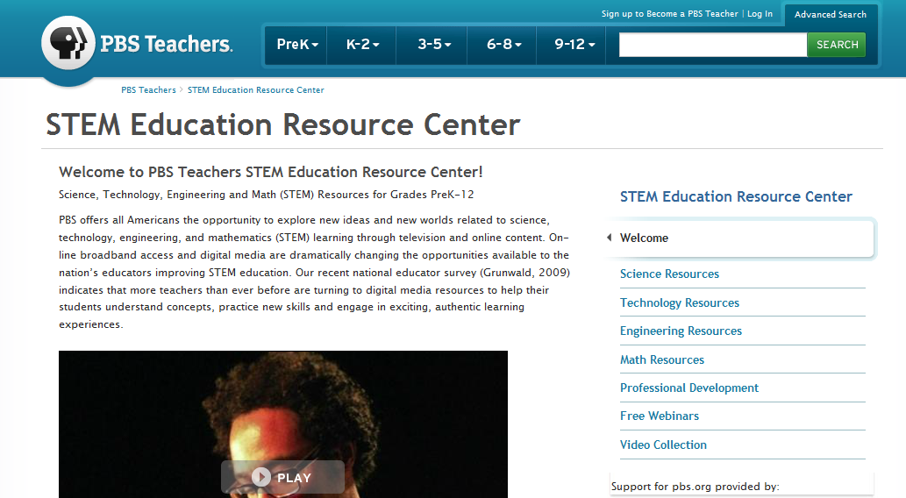
Content Resources
STEM Education Resource Center
PBS Kids

Slide 34
Content Resources
HippoCampus

Slide 35
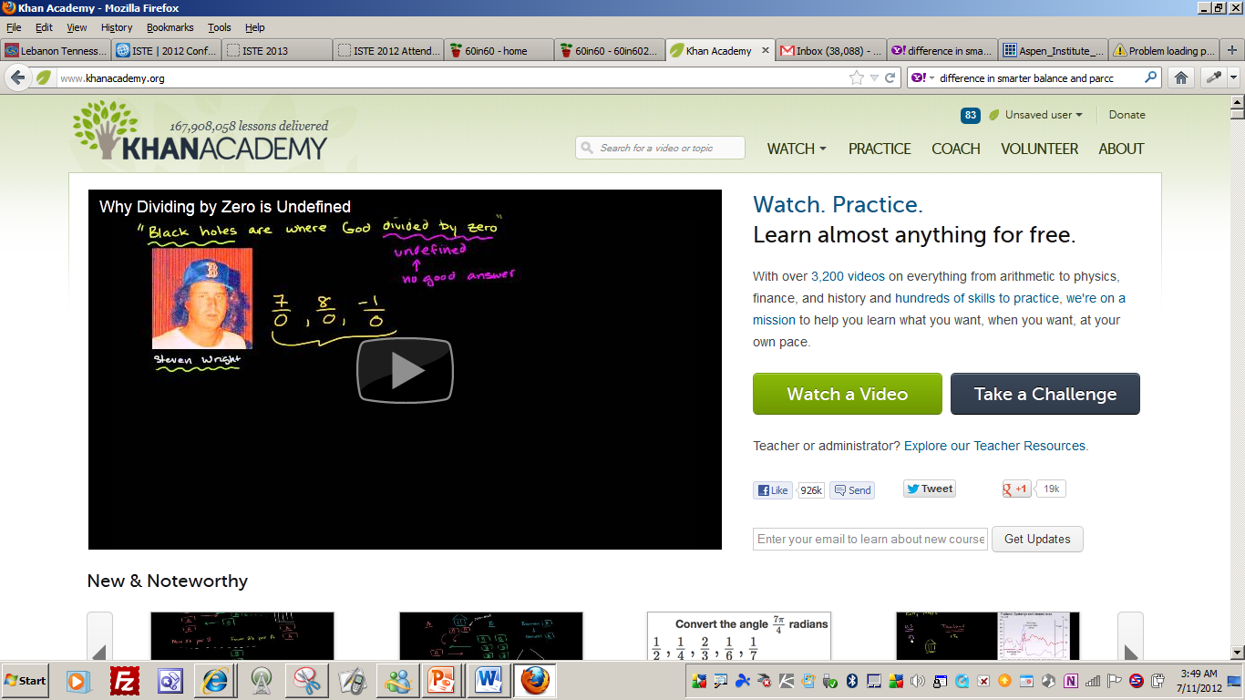
Content Resources
Khan Academy

Slide 36
Learning Games (Experiences) with Real World Connections
CSI – The Experience
Nobelprize.org - These games and simulations, based on Nobel Prize-awarded achievements, will teach and inspire you while you’re having FUN!
TryEngineering
Edheads

Slide 37
HHMI Cool Science
VIRTUAL LABS

Slide 38
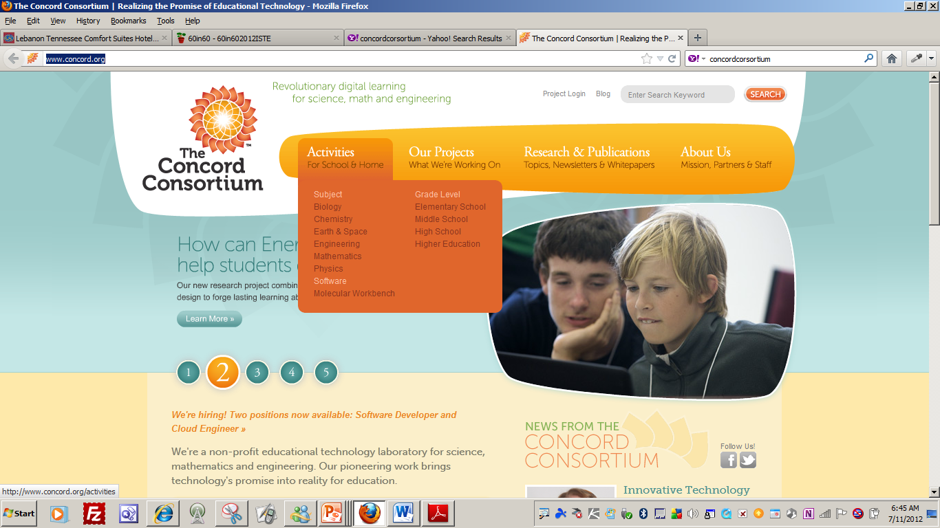
Analysis
Concord Consortium
Diffusion
Build a Wind Turbine

Slide 39
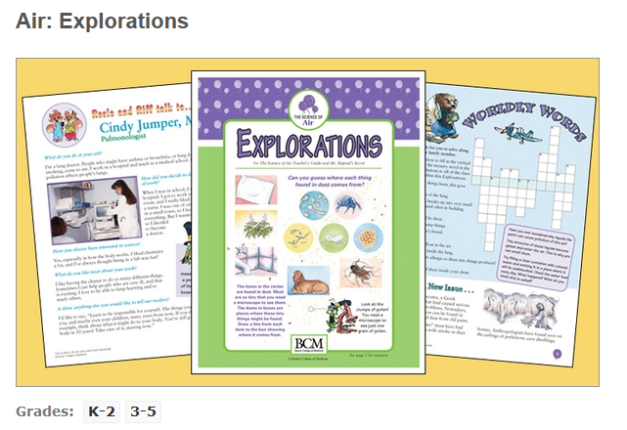
BioEd Online

Slide 40
Assessment Tools
Google Forms
Flubaroo
Ways to use Google Forms
Quizzes
Surveys
Rubrics and more

Slide 41
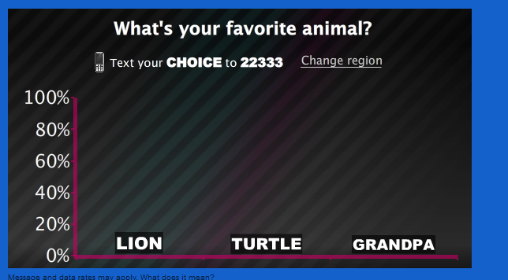
Assessment Tools
Poll Everywhere
Poll Everywhere is free for audiences of 40 people or less and we offer paid plans for larger audiences. K-12 and Higher Education semester-long plans are also available.

Slide 42
Assessment Tools
That Quiz
Mathematics Assessment Project
Smarter Balance Assessments
Jeopardy Labs

Slide 43
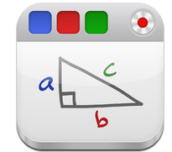
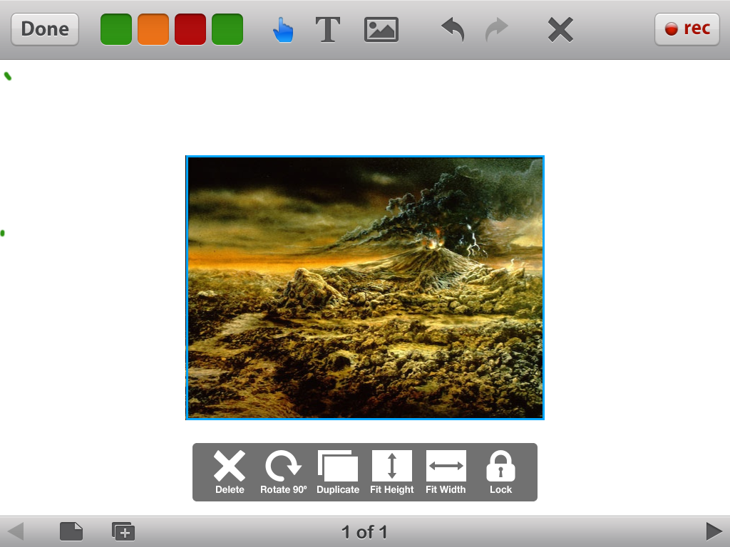
STUDENT CREATED WORK
APPs
EDUCREATION
PUPPET PALS
Create your own unique shows with animation and audio in real time!
SOCK PUPPETS
Create your own lip-synched videos and share them.
Story Kit
Create an electronic storybook.

Slide 44
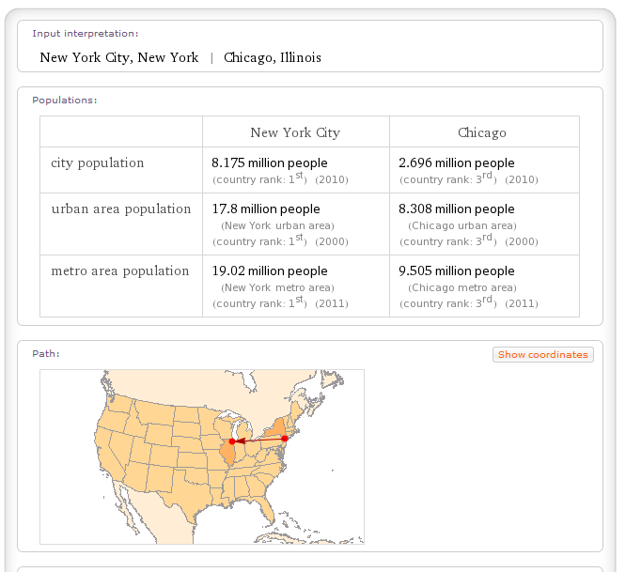
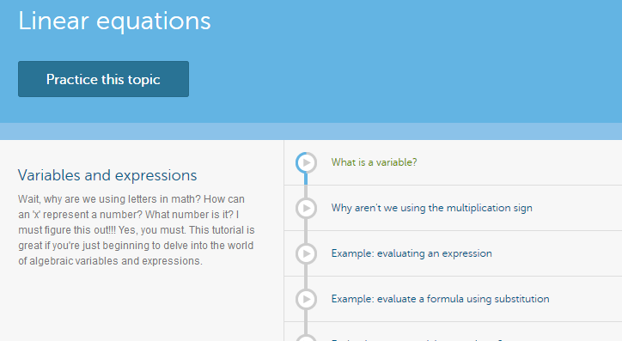
Teaching Sites for Student Learning
Khan Academy
Wolfram Alpha

Slide 45
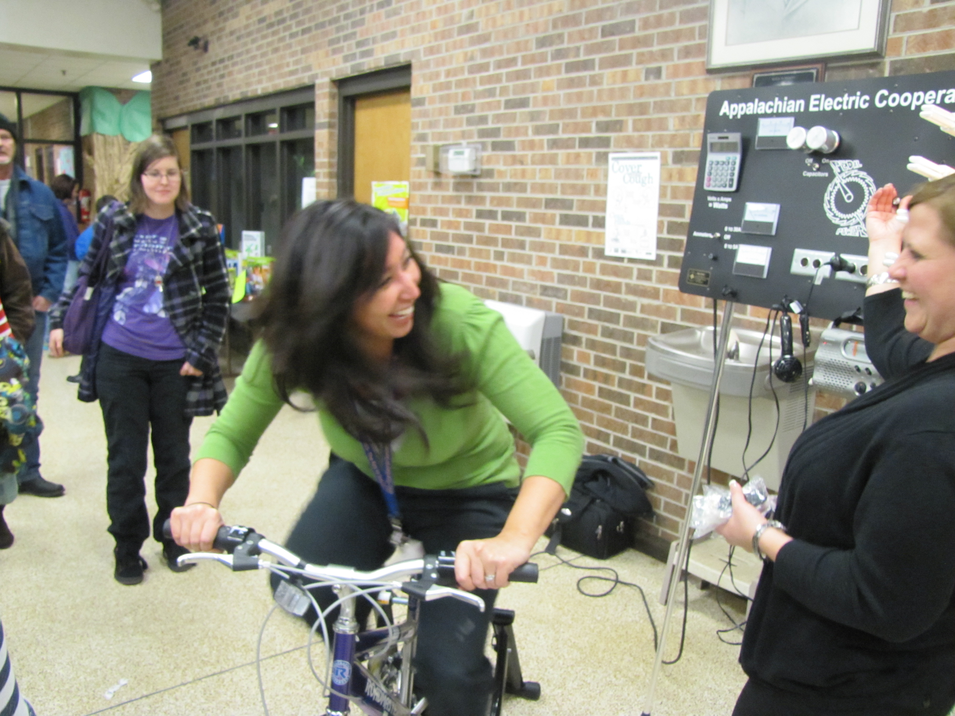
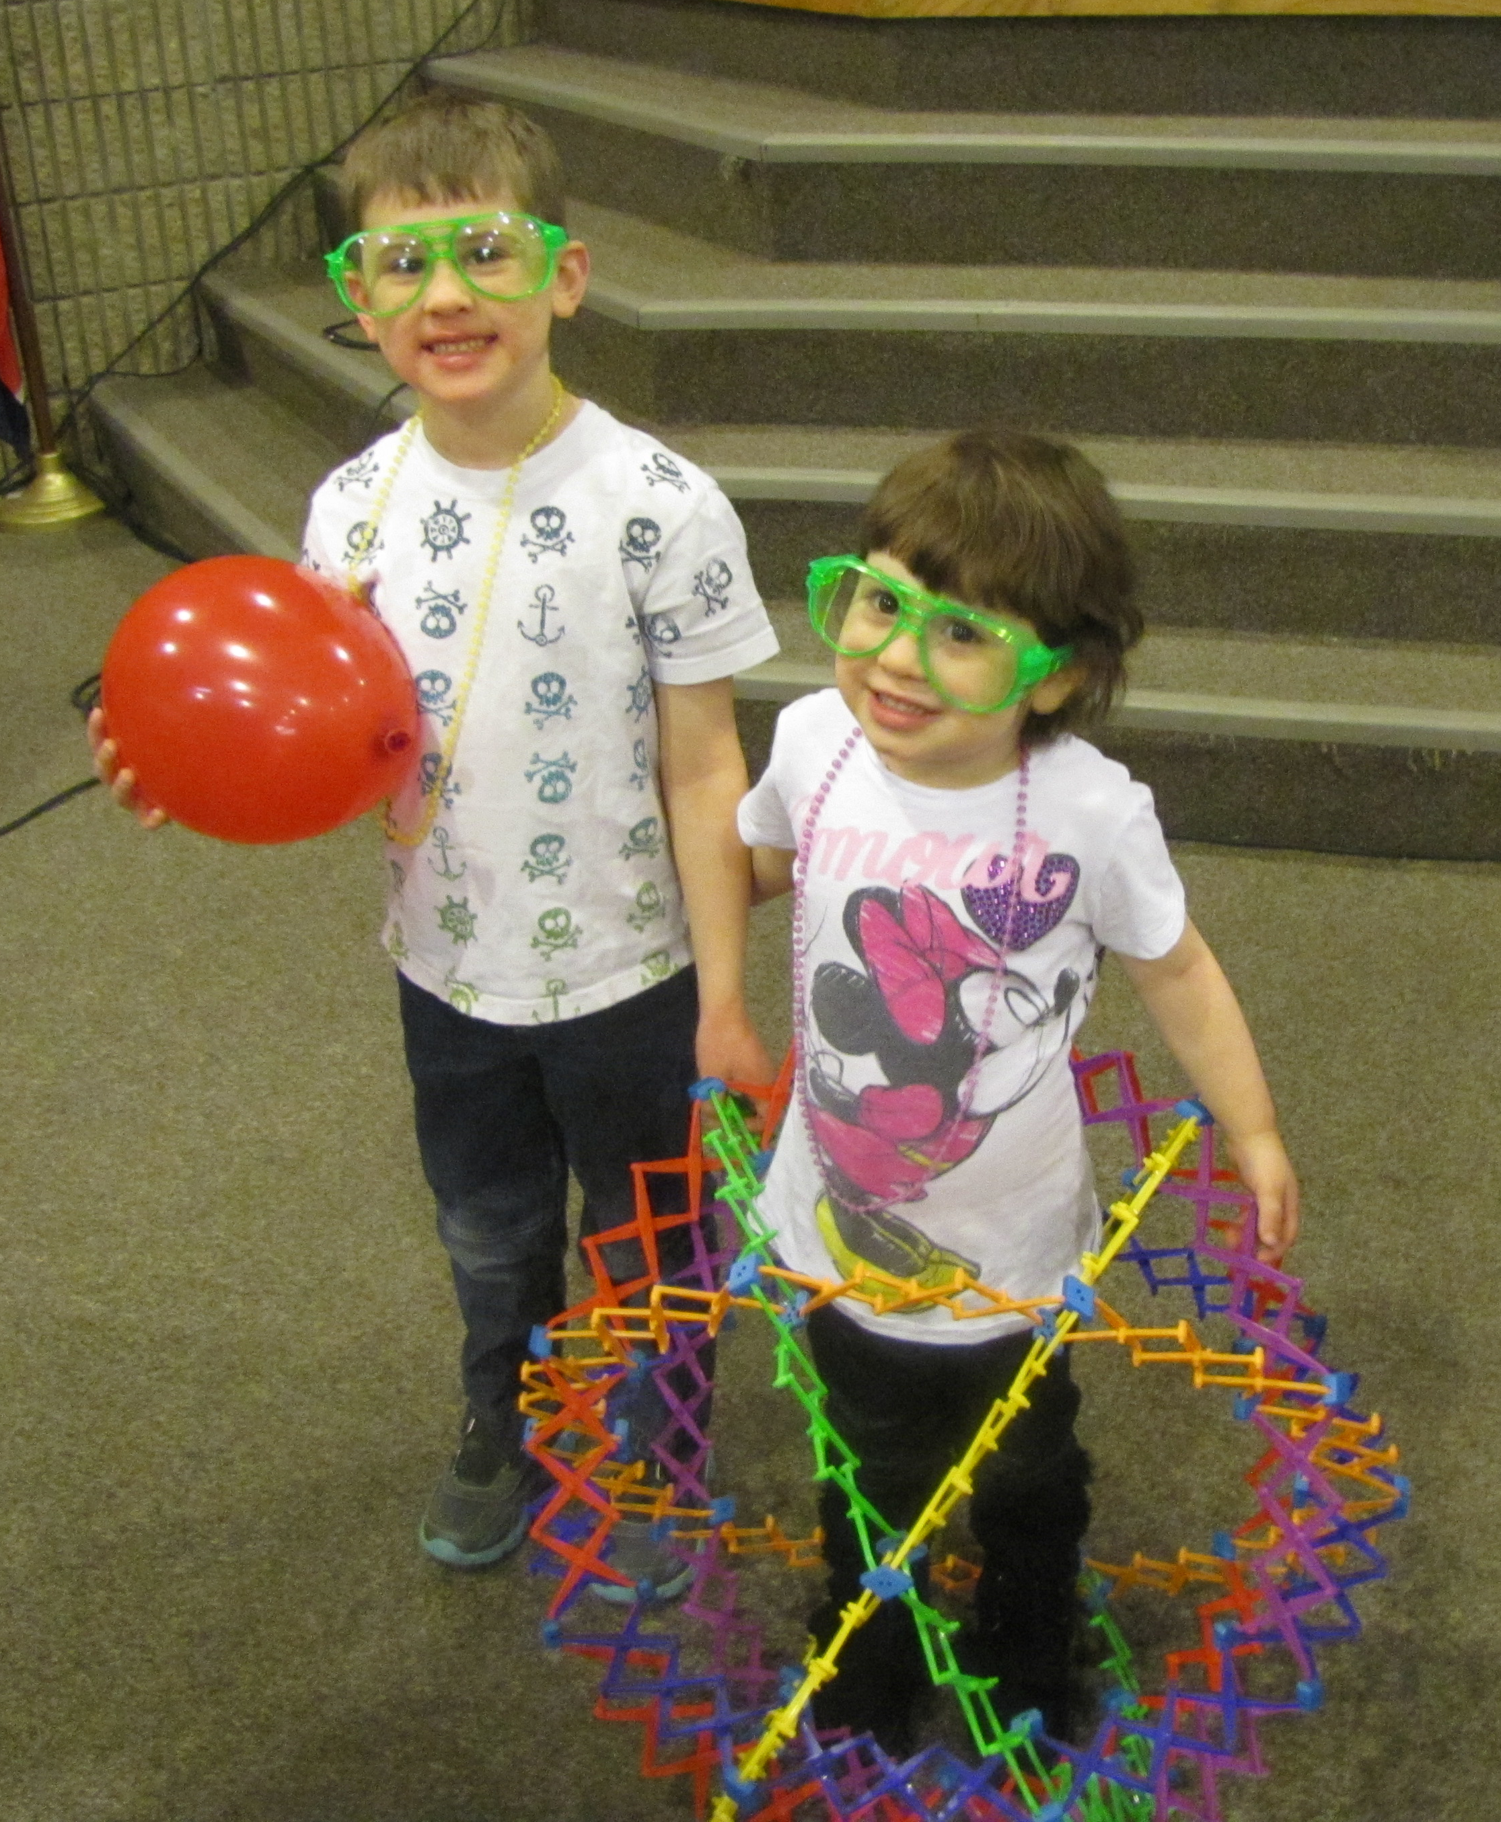
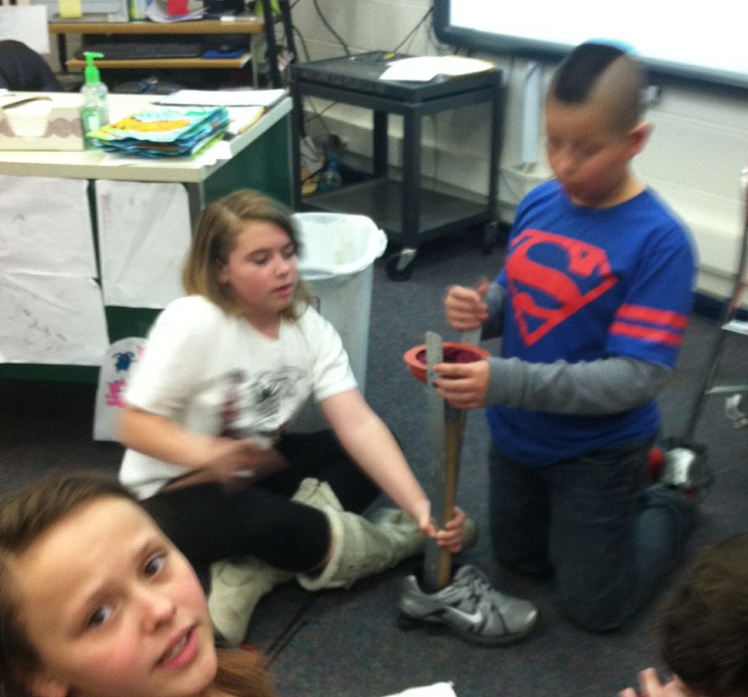
STEM

Slide 46
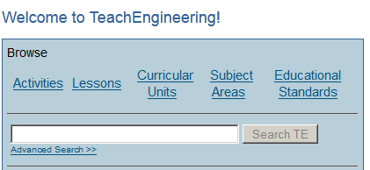
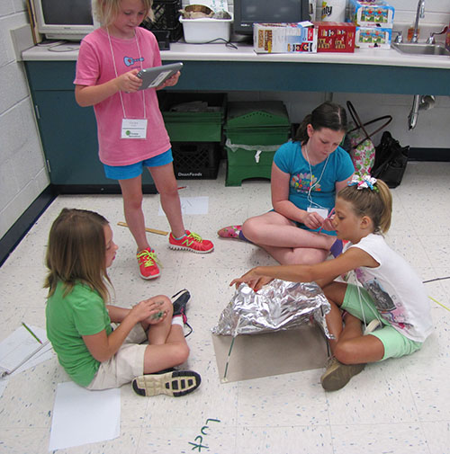
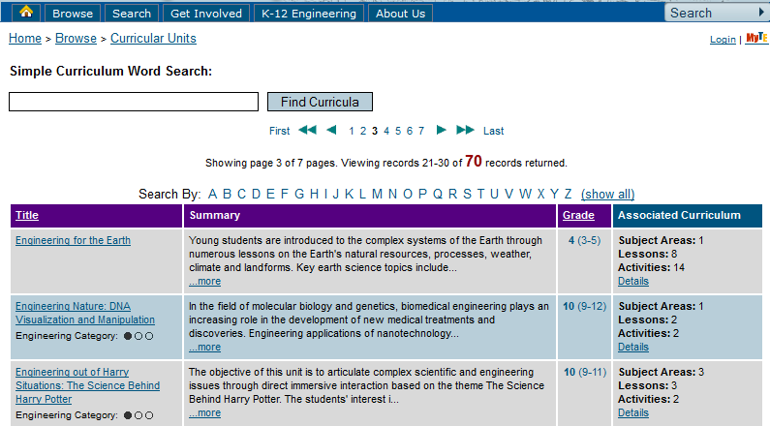

Slide 47
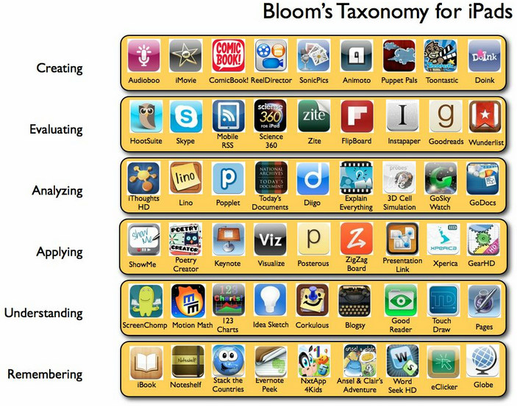
http://langwitches.org/blog/2012/03/31/ipad-apps-and-blooms-taxonomy/

