Slide 1
STEM Education
Resources for your school
http://jc-schools.net/STEM
Jan Coley
Jefferson County Schools
jcoley@jcboe.net

Slide 2
What is STEM education?
Real world
Guided by EDP
science
Technology
Engineering
Mathematics
Stem develops a set of skills including: problem solving, critical thinking, teamwork, investigation, creative, and communication.
rigor
Team work
Inquiry and open ended

Slide 3
Why do we need STEM education?
There is an ever increasing need for worker to fill the needs of the science and engineering field. This demand is closely linked to our need for global competiveness. Both women and Hispanics (fastest growing population in U.S.) are under-represented in the STEM fields.
The U.S. Bureau of Labor Statistics projects that, during the period 2010–2020, employment in S&E occupations will grow by 18.7%, compared to 14.3% for all occupations.

Slide 4
resources
Resources for your school
Paper helicopter

Slide 5
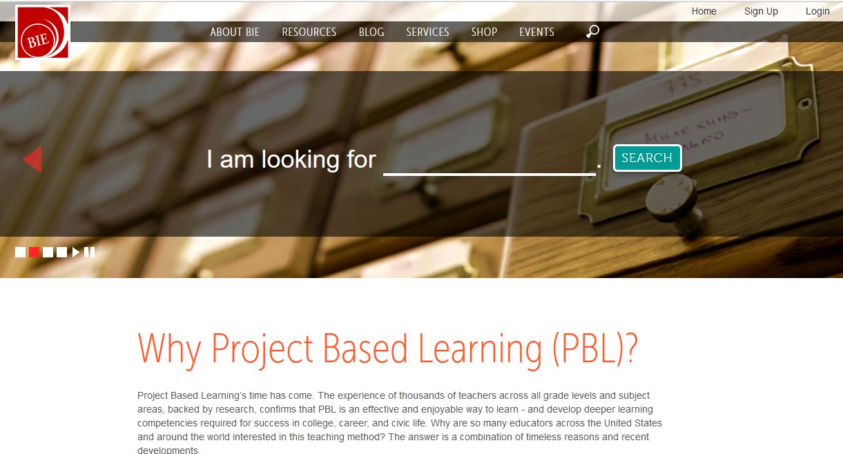
PBL
Buck Institute for Education (BIE)

Slide 6
Engineering
National Engineers Week February 17- 25, 2017
February 23 – Introduce a girl to engineering day
Resources and Downloads
Content and activities

Slide 7
Favorite engineering resources
Building Big (PBS)
Design Squad(PBS)
Teach Engineering
Try Engineering
eGFI (Engineering, Go For It) American Society for Engineering Education (ASEE).

Slide 8
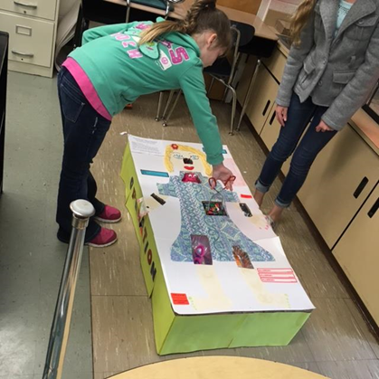
Cardboard challenge resources
http://cardboardchallenge.com/
http://cainesarcade.com/cardboardchallenge/

Slide 9
Favorite sites
Comic Creator http://www.readwritethink.org/files/resources/interactives/comic/
Perfect Pitch http://www.artsedge.kennedy-center.org/perfectpitch/
Marble Mania http://www.sciencenetlinks.com/interactives/marble/marblemania.html
Touch of Class http://www.sciencenetlinks.com/interactives/class.html
Power Up http://www.sciencenetlinks.com/interactives/powerup.html
Dynamic Paper http://illuminations.nctm.org/ActivityDetail.aspx?ID=205
Break it Down http://www.sciencenetlinks.com/interactives/breakitdown.html
Make A Mission http://www.sciencenetlinks.com/messenger/mission.htm

Slide 10
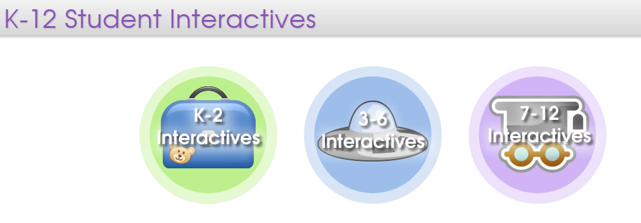
Learning Games – grades 3-5
Kinetic City From AAAS with support from NSF
Utah Education Network – K-12 Student Interactives
Wonderville

Slide 11
SUPPORTING GIRLS IN STEM
SciGirls – PBS Science for tween girls
National Girl’s Collaborative Project
Girl’s Raised in TN Science (GRITS)
Million Women Mentors

Slide 12
Engineering is Elementary

Slide 13
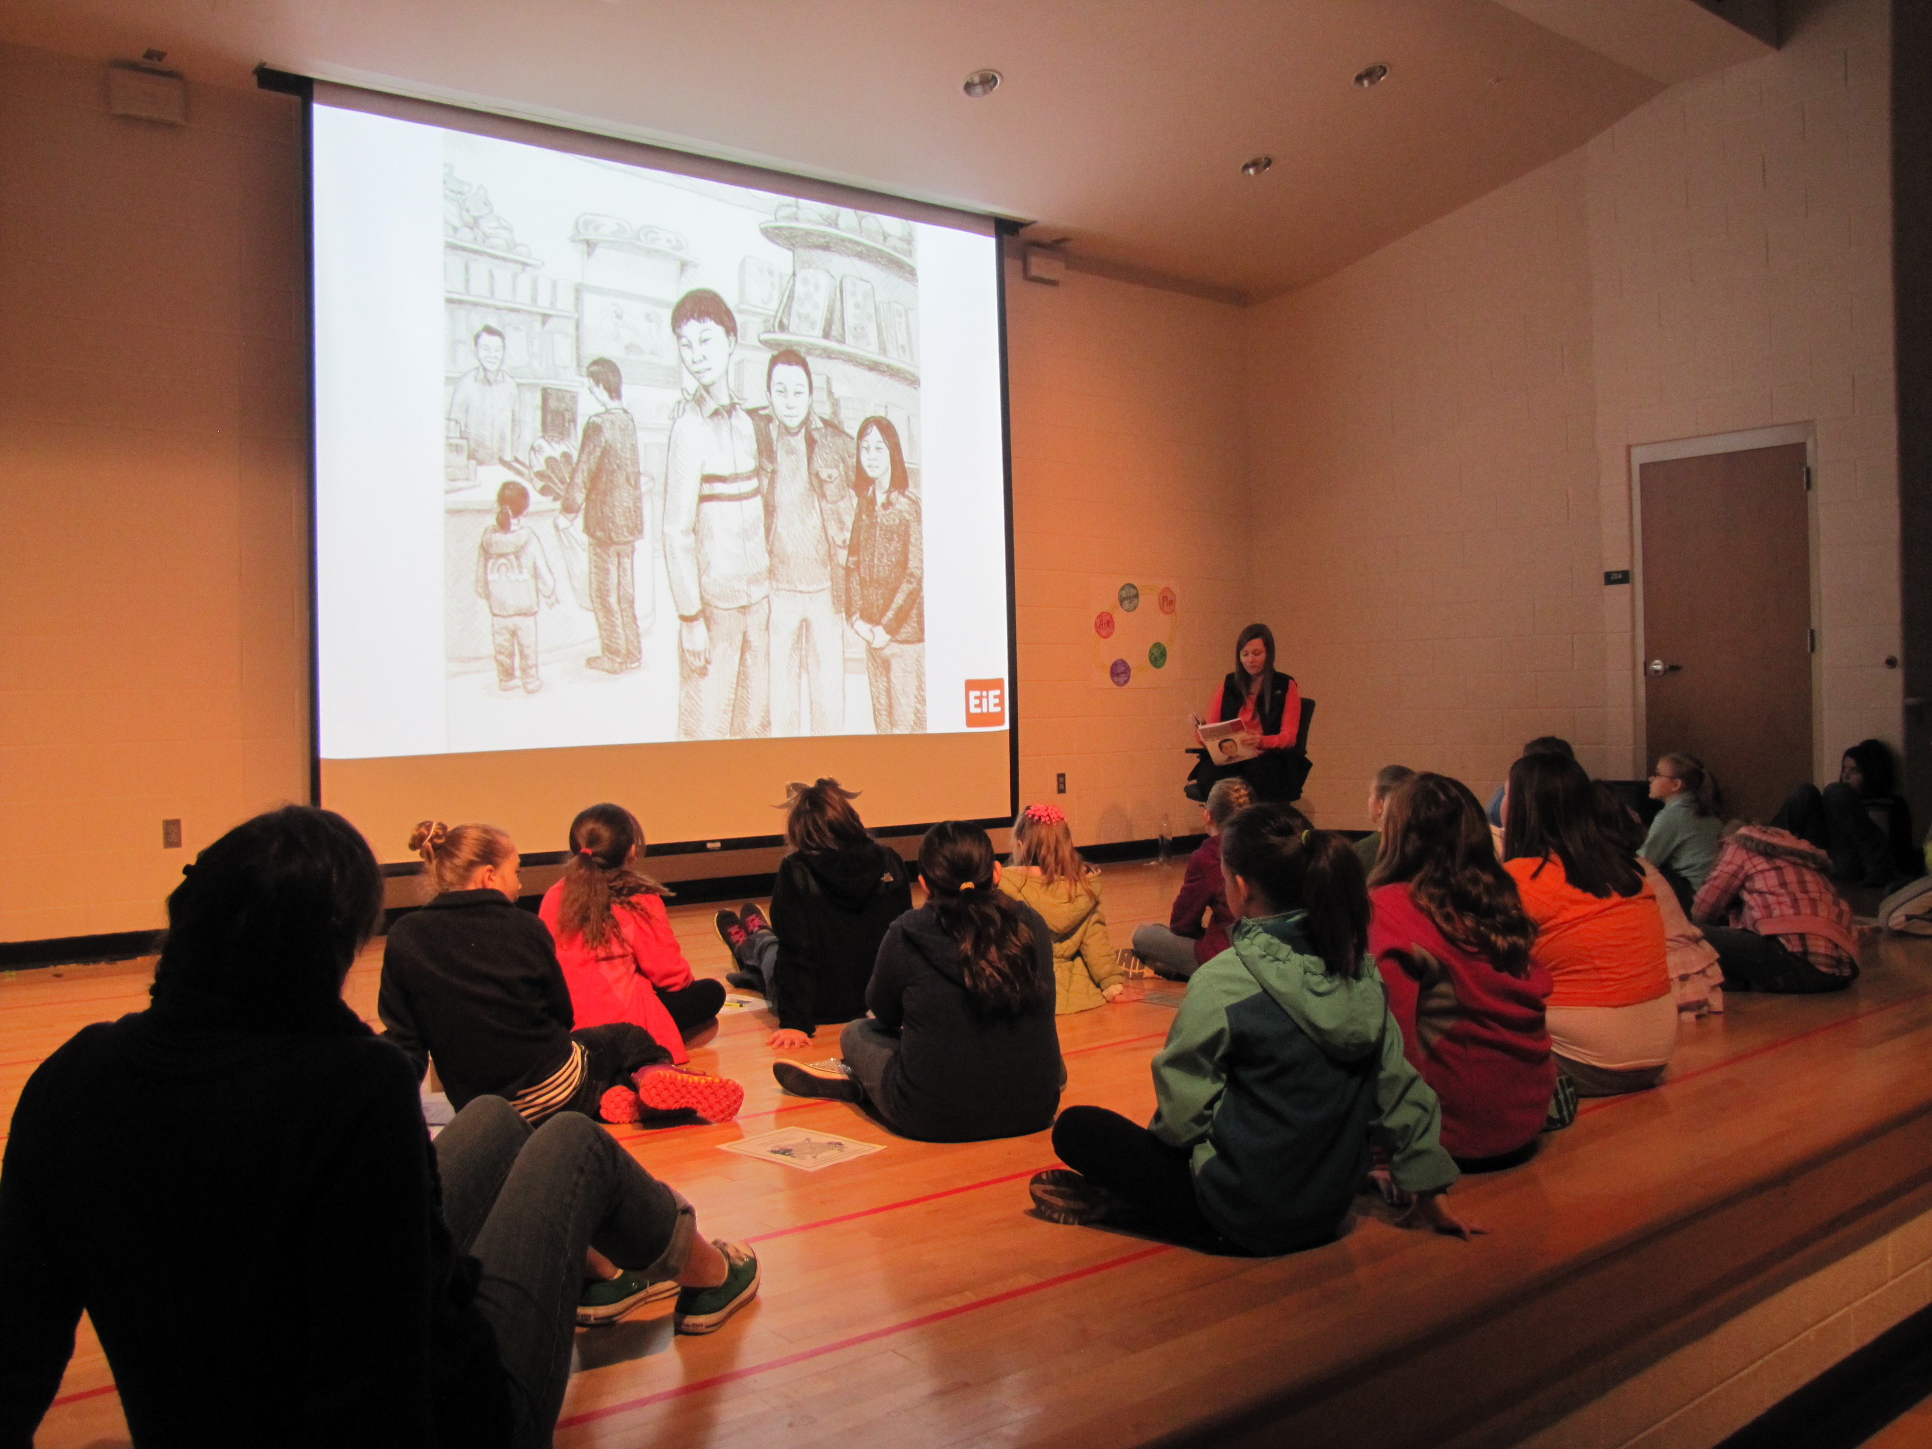
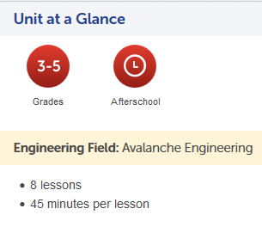
Curriculum 20 cross-curricular units consisting of three components: a teacher guide, storybook and materials kit.
Engineering Adventures – Grades 3 -5 (Free units)

Slide 14
World Wide Telescope

Slide 15
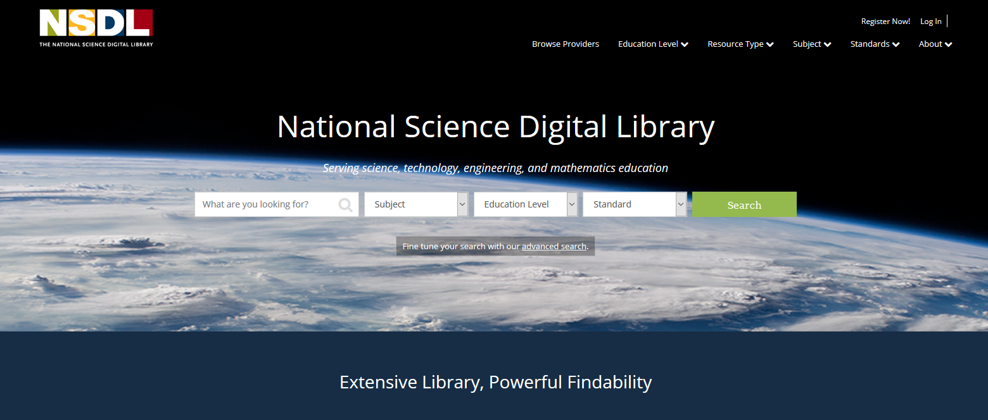
National science digital library

Slide 16
Exploratorium
Newspaper Bridges
Online Activities
Site includes:
Treasure Trove
Learning Resources Library from National Science Digital Library (NSDL).
Special Collections including a microscope imaging station, math explorer database, webcasts, podcasts and media downloads

Slide 17
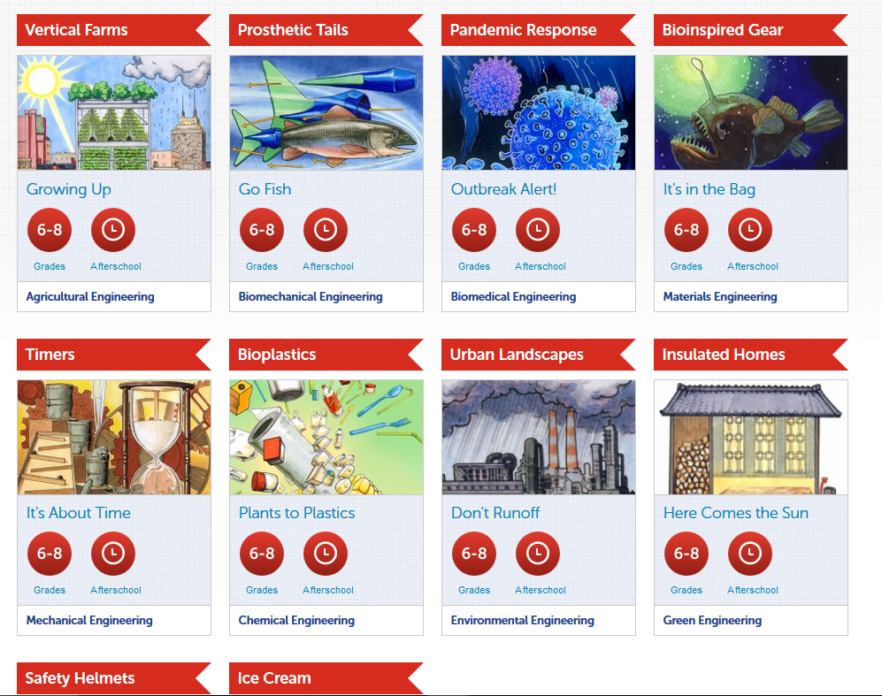
Engineering is Everywhere – Middle School (Free units)

Slide 18
Concord.org
Concord Consortium – non-profit educational technology laboratory (funded by NSF) for science, mathematics and engineering. The Concord Consortium includes models and simulations, real time data collection with probeware, as well as modeling software. Resources are categorized by subject and grade band (elementary, middle, high and higher ed). There is a STEM finder to assist with locating STEM activities and lessons.
Funding is provided by NSF and Google and partnerships with institutions such as Harvard, Berkeley, MIT’s edX, National Geographic, the New York Hall of Science and many more.

Slide 19
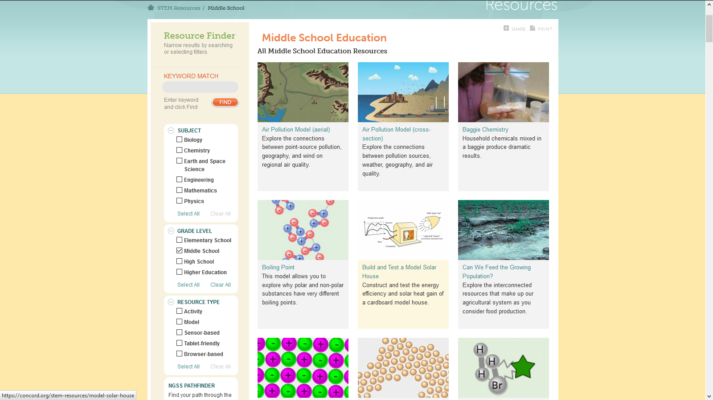
Example: diffusion

Slide 20
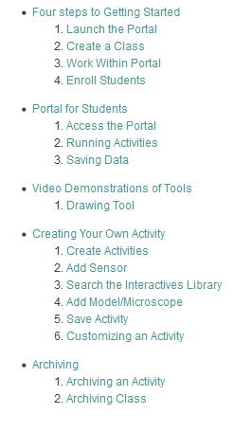
Innovation Technology and Science Inquiry Project.
Free to use
Teachers may assign and track student work using the Innovation Technology and Science Inquiry Project. Portal

Slide 21
Texas instruments

Slide 23
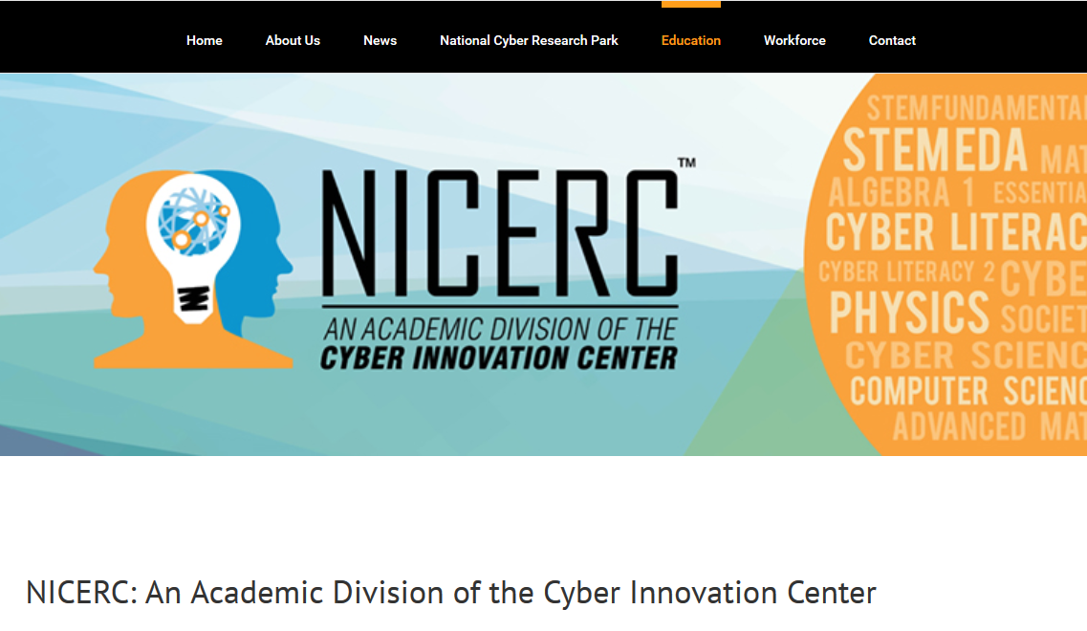

Slide 24
NICERC works with its partners to design project-driven, application-based curricula that engages students across primary, secondary, and post-secondary grade levels. The Department of Homeland Security has identified NICERC as the national model for cyber education thus allows for the free distribution of content and curricula.
Informal Education
Professional Development

Slide 25
Howard hughes medical institute
Howard Hughes Medical Institute offers educators many resources. From the home page, select Educational Materials, scroll to the bottom of the page and locate Order Materials. Click on browse and choose from any or all of the free materials (short videos, Holiday Lectures Series, and virtual labs). Educators may order DVD’s of selections and they will be mailed free in North America. The Click and Learn App is available from the Apple Store, Google Play and Amazon Apps. Earth Viewer is another App from HHMI. This is also available from the Apple Store, Google Play and Amazon Apps. Many resources are also available in Spanish.

Slide 26
Activities, featured films, short films, teacher guides, ebooks, apps, virtual labs, online courses, free materials for teachers.

Slide 27
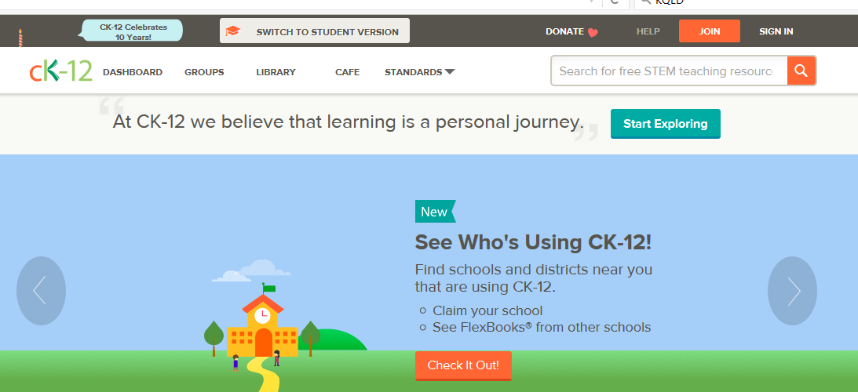
cK-12.org

Slide 28
NBC LEARN K-12 is an educational portal from NBC News. It provides the latest news as well as historical perspectives on many events. It is a collection of 20,000 videos which are aligned to state standards designed for use in the classroom. There are collection including: Science of Innovation, Science of Sports, and Chronicles of Courage. NBC Learn now has a separate site for higher education: NBC Learn Higher ED.

Slide 29
Science 360 /video Library is sponsored by the National Science Foundations. The site contains current science news from across the world. There are video collections and following are a sampling:
Physics - Science360 - Video Library
Science of Sports
Innovation
Ask a Scientist
There is also a Science 360 Radio App available in the Apple Store and Google Play

Slide 30
Bozeman Science
This site is developed by Paul Andersen is an educational consultant and YouTube creator living in Bozeman, MT. He was a one of four finalists in 2011 for the National Teacher of the Year. In 2012 Paul was selected by YouTube as one of ten YouTube Edu Gurus. The videos on this site include information for: AP Biology, AP Chemistry, AP Environmental Science, AP Physics, Anatomy and Physiology as well as the Next Generation Science Standards.

Slide 31
Science NetLinks

Slide 32
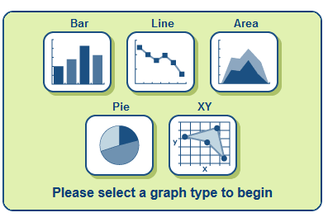
Create a Graph is an on-line tool to aid with making graphs. The site offers tutorials, help with the type of graph needed, and creates basic types of graphs. There are place holders for students to label axis, title, legend, etc. guiding students to create better graphs. Graphs may be shared, printed or saved.

Slide 33
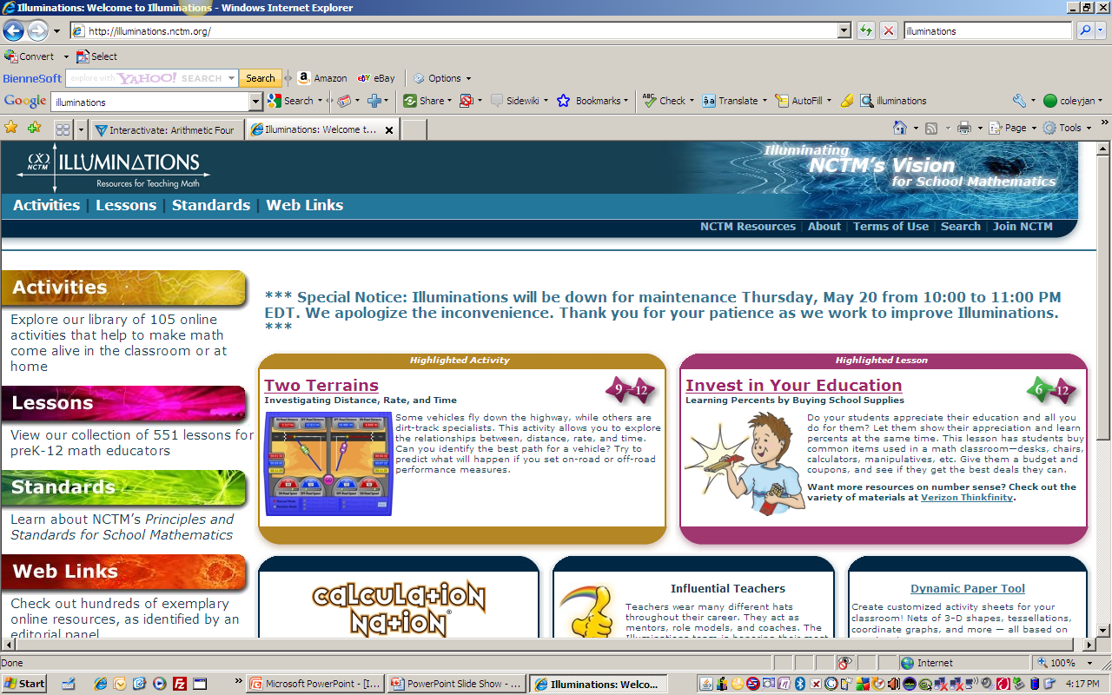
Illuminations

Slide 34
CSI – The Experience

Slide 35
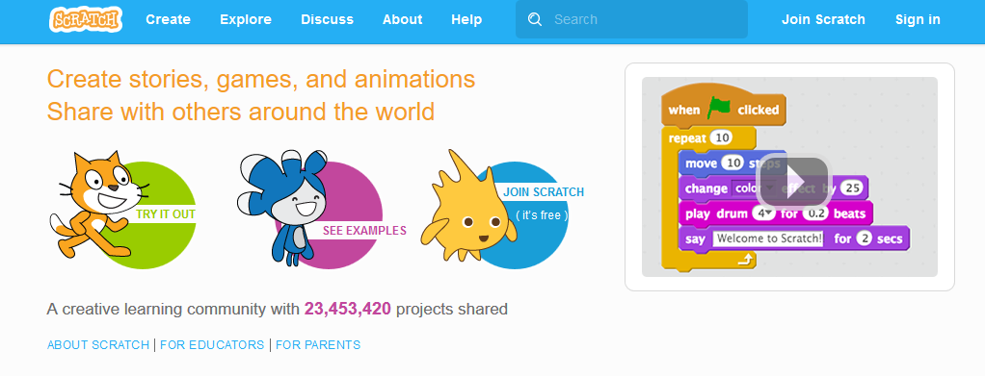
cODING
Code.org
scratch

Slide 36
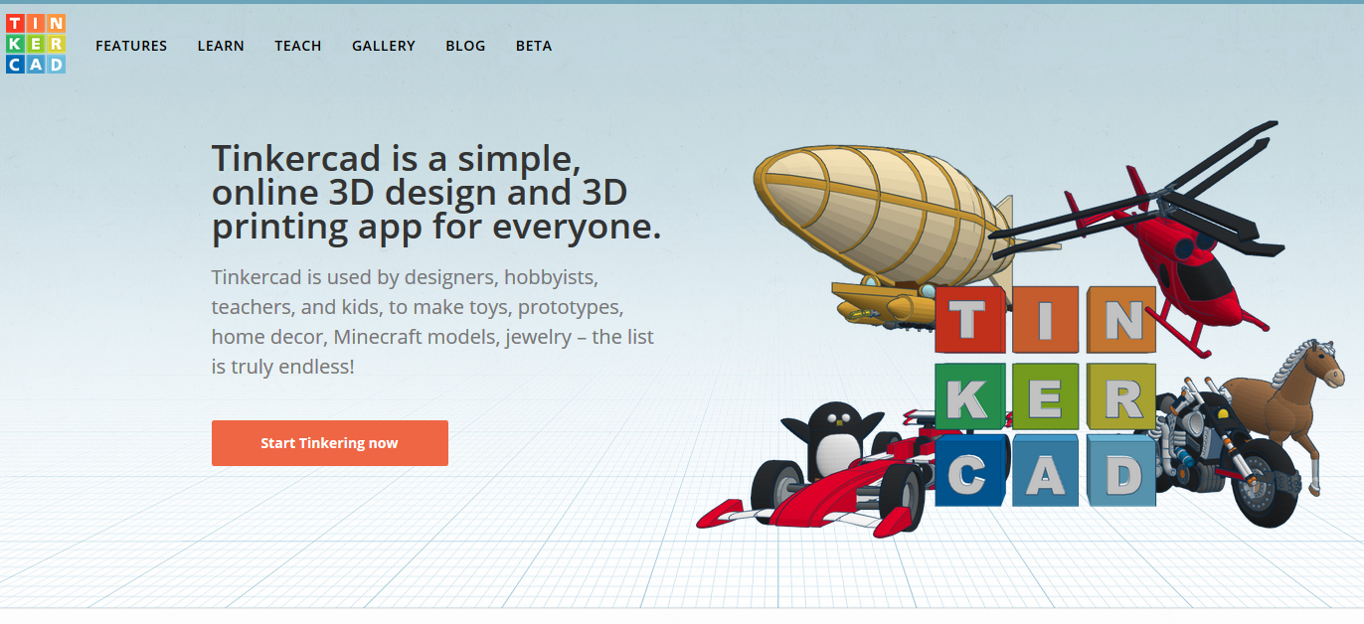
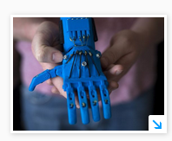
3D printing

Slide 37
Interactive simulations for math and science
PhET was founded in 2002 by Nobel Laureate Carl Wieman. The PhET Interactive Simulations project at the University of Colorado Boulder creates free, research-based interactive math and science simulations.

Slide 38
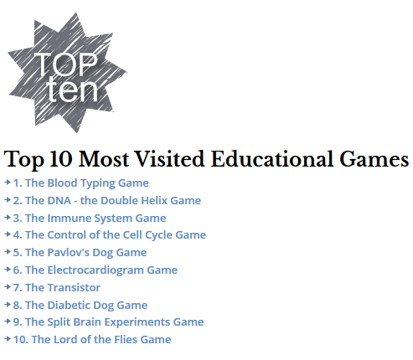

Slide 39
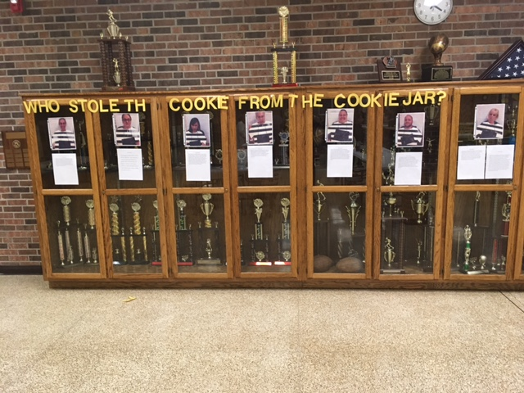
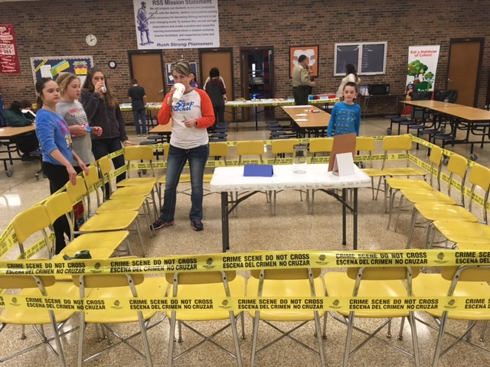
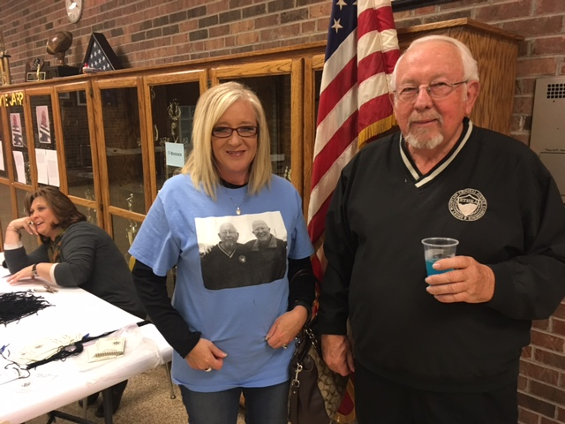
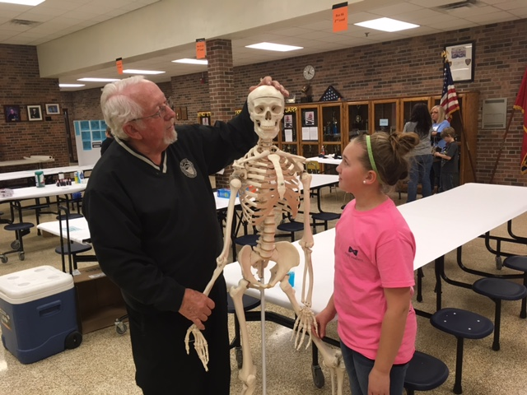
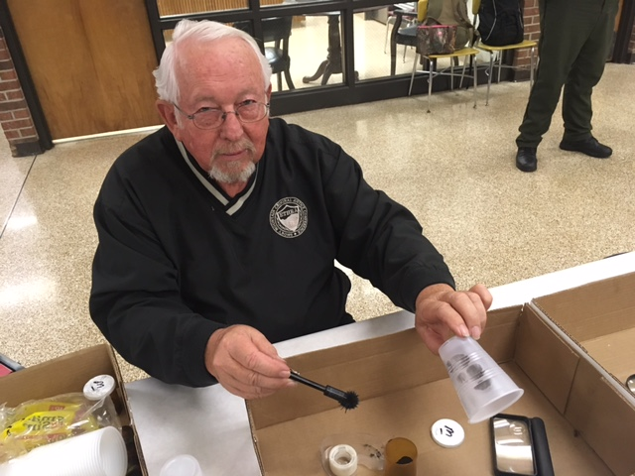
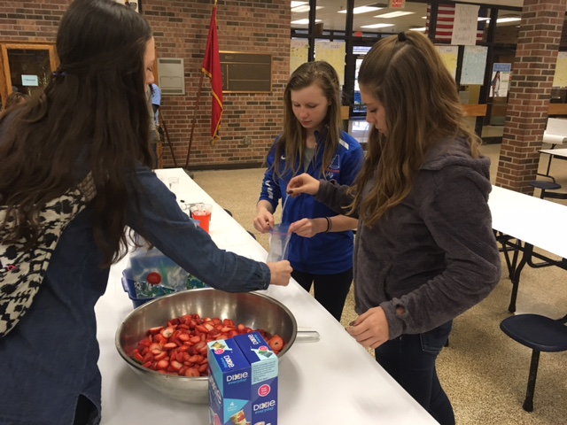
STEM Family Nights

Slide 40
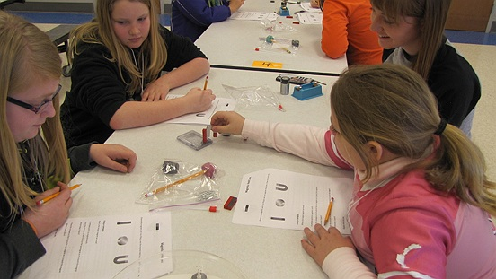
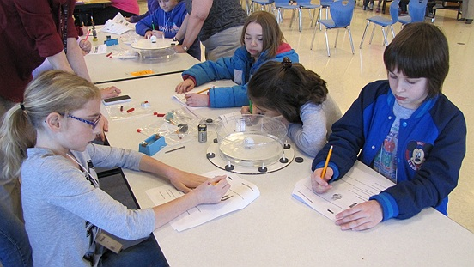
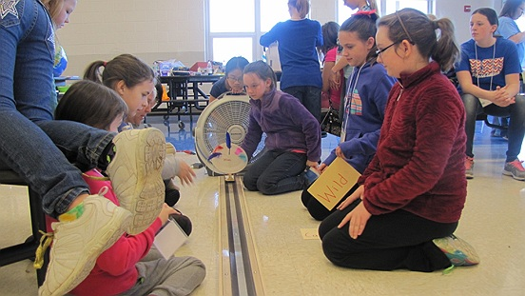
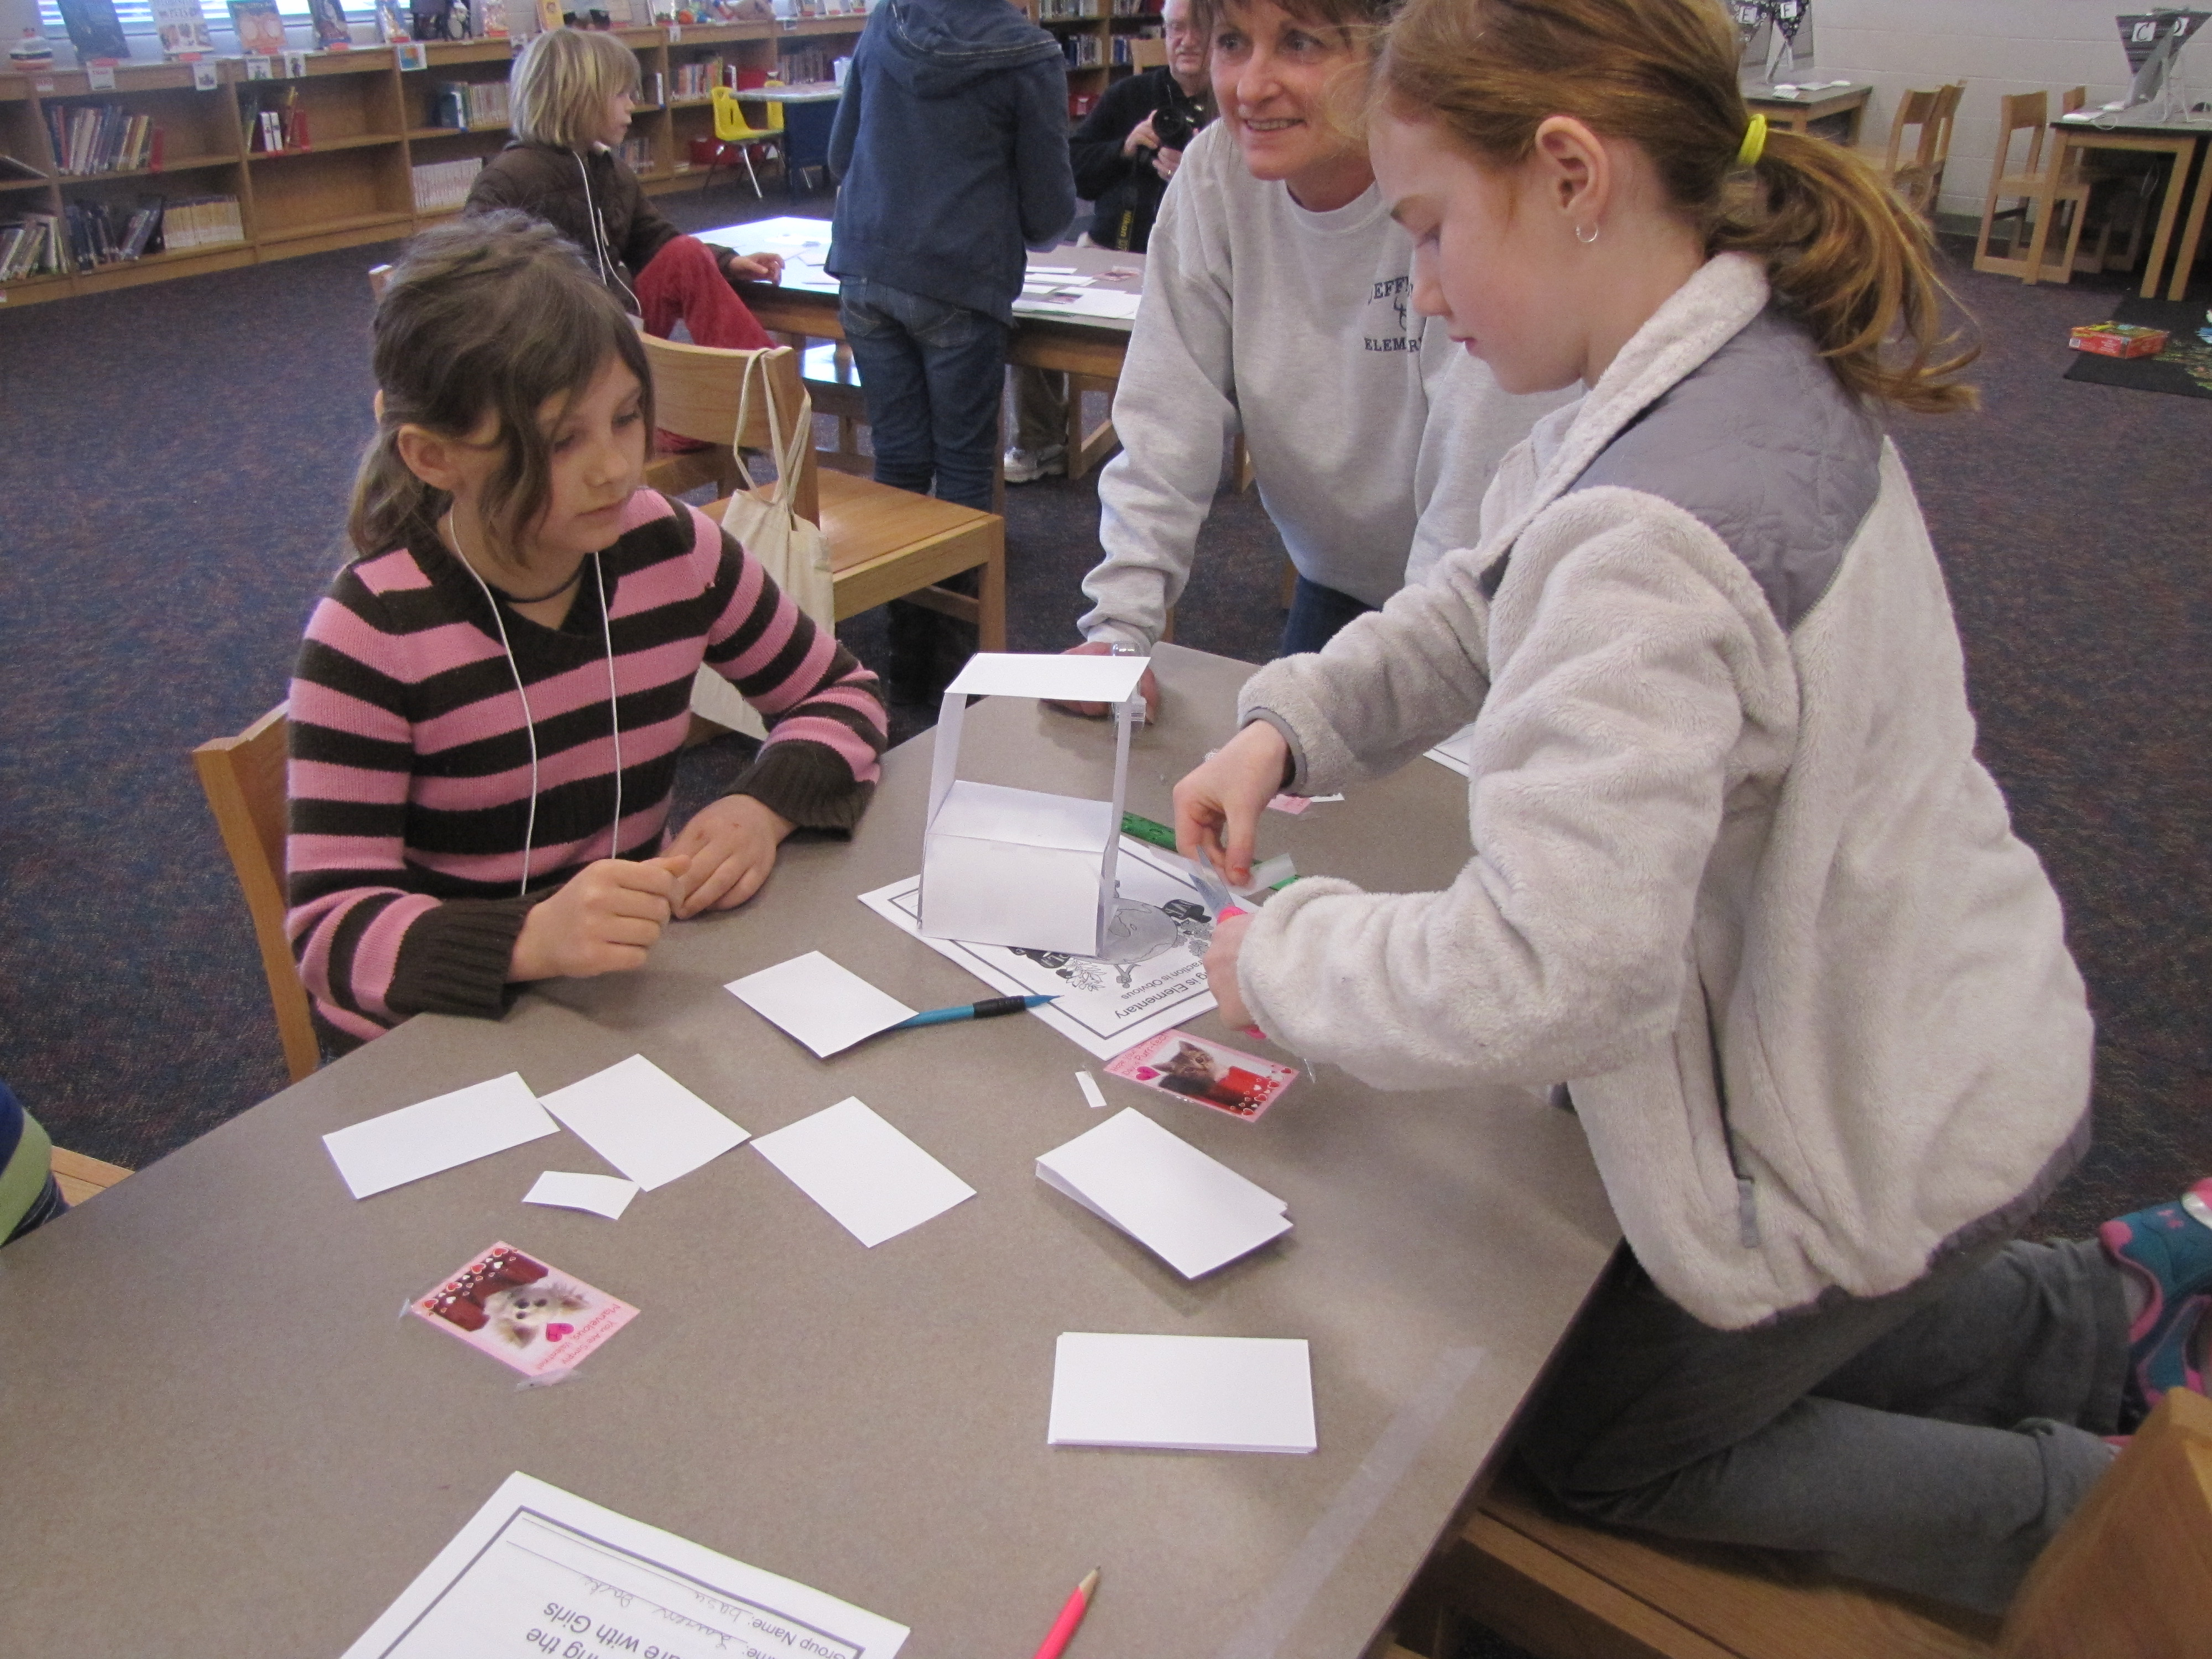
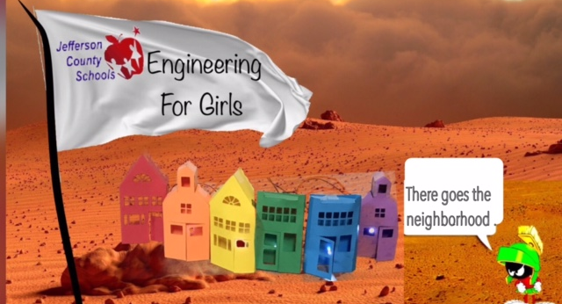
Engineering the Future with Girls

Slide 41
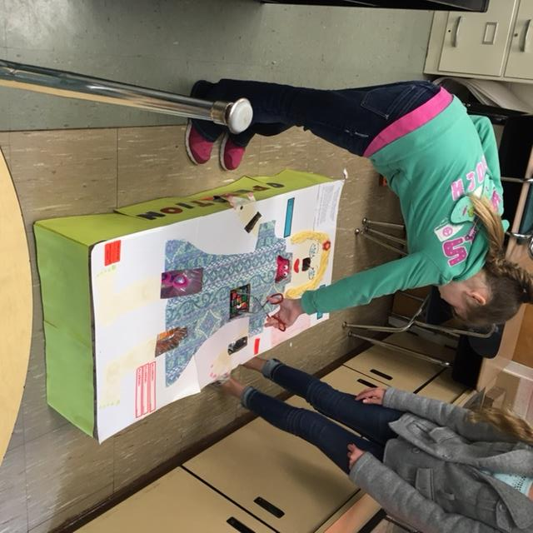
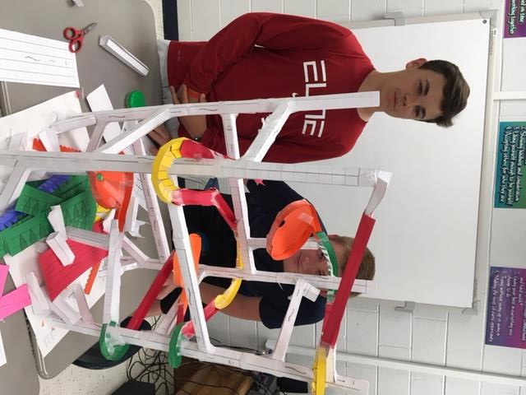
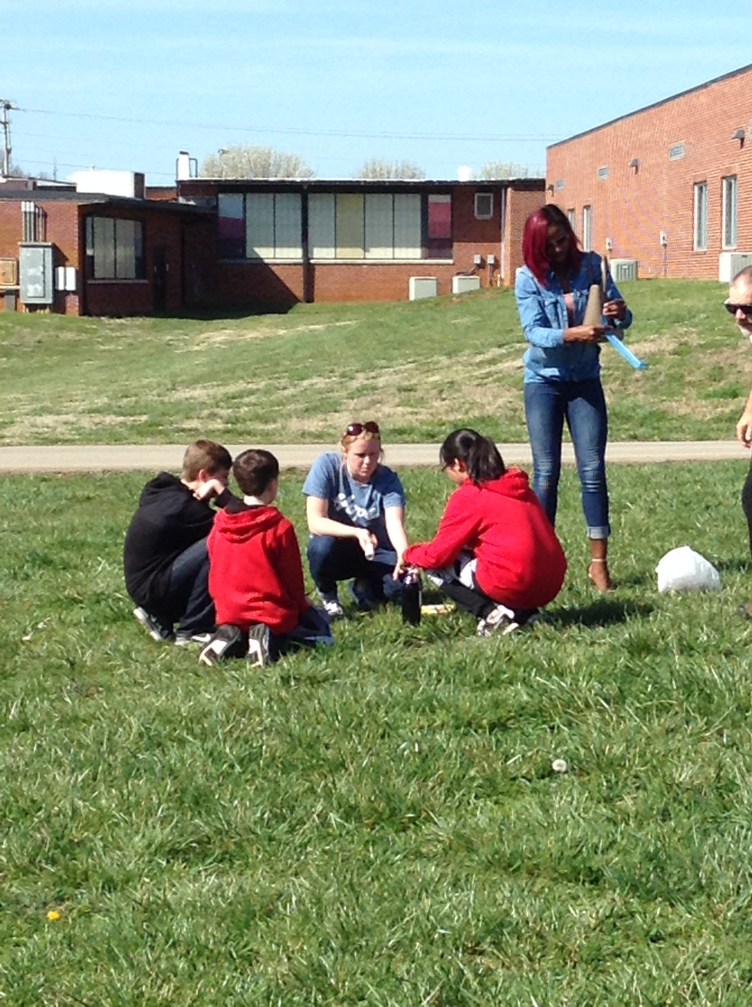
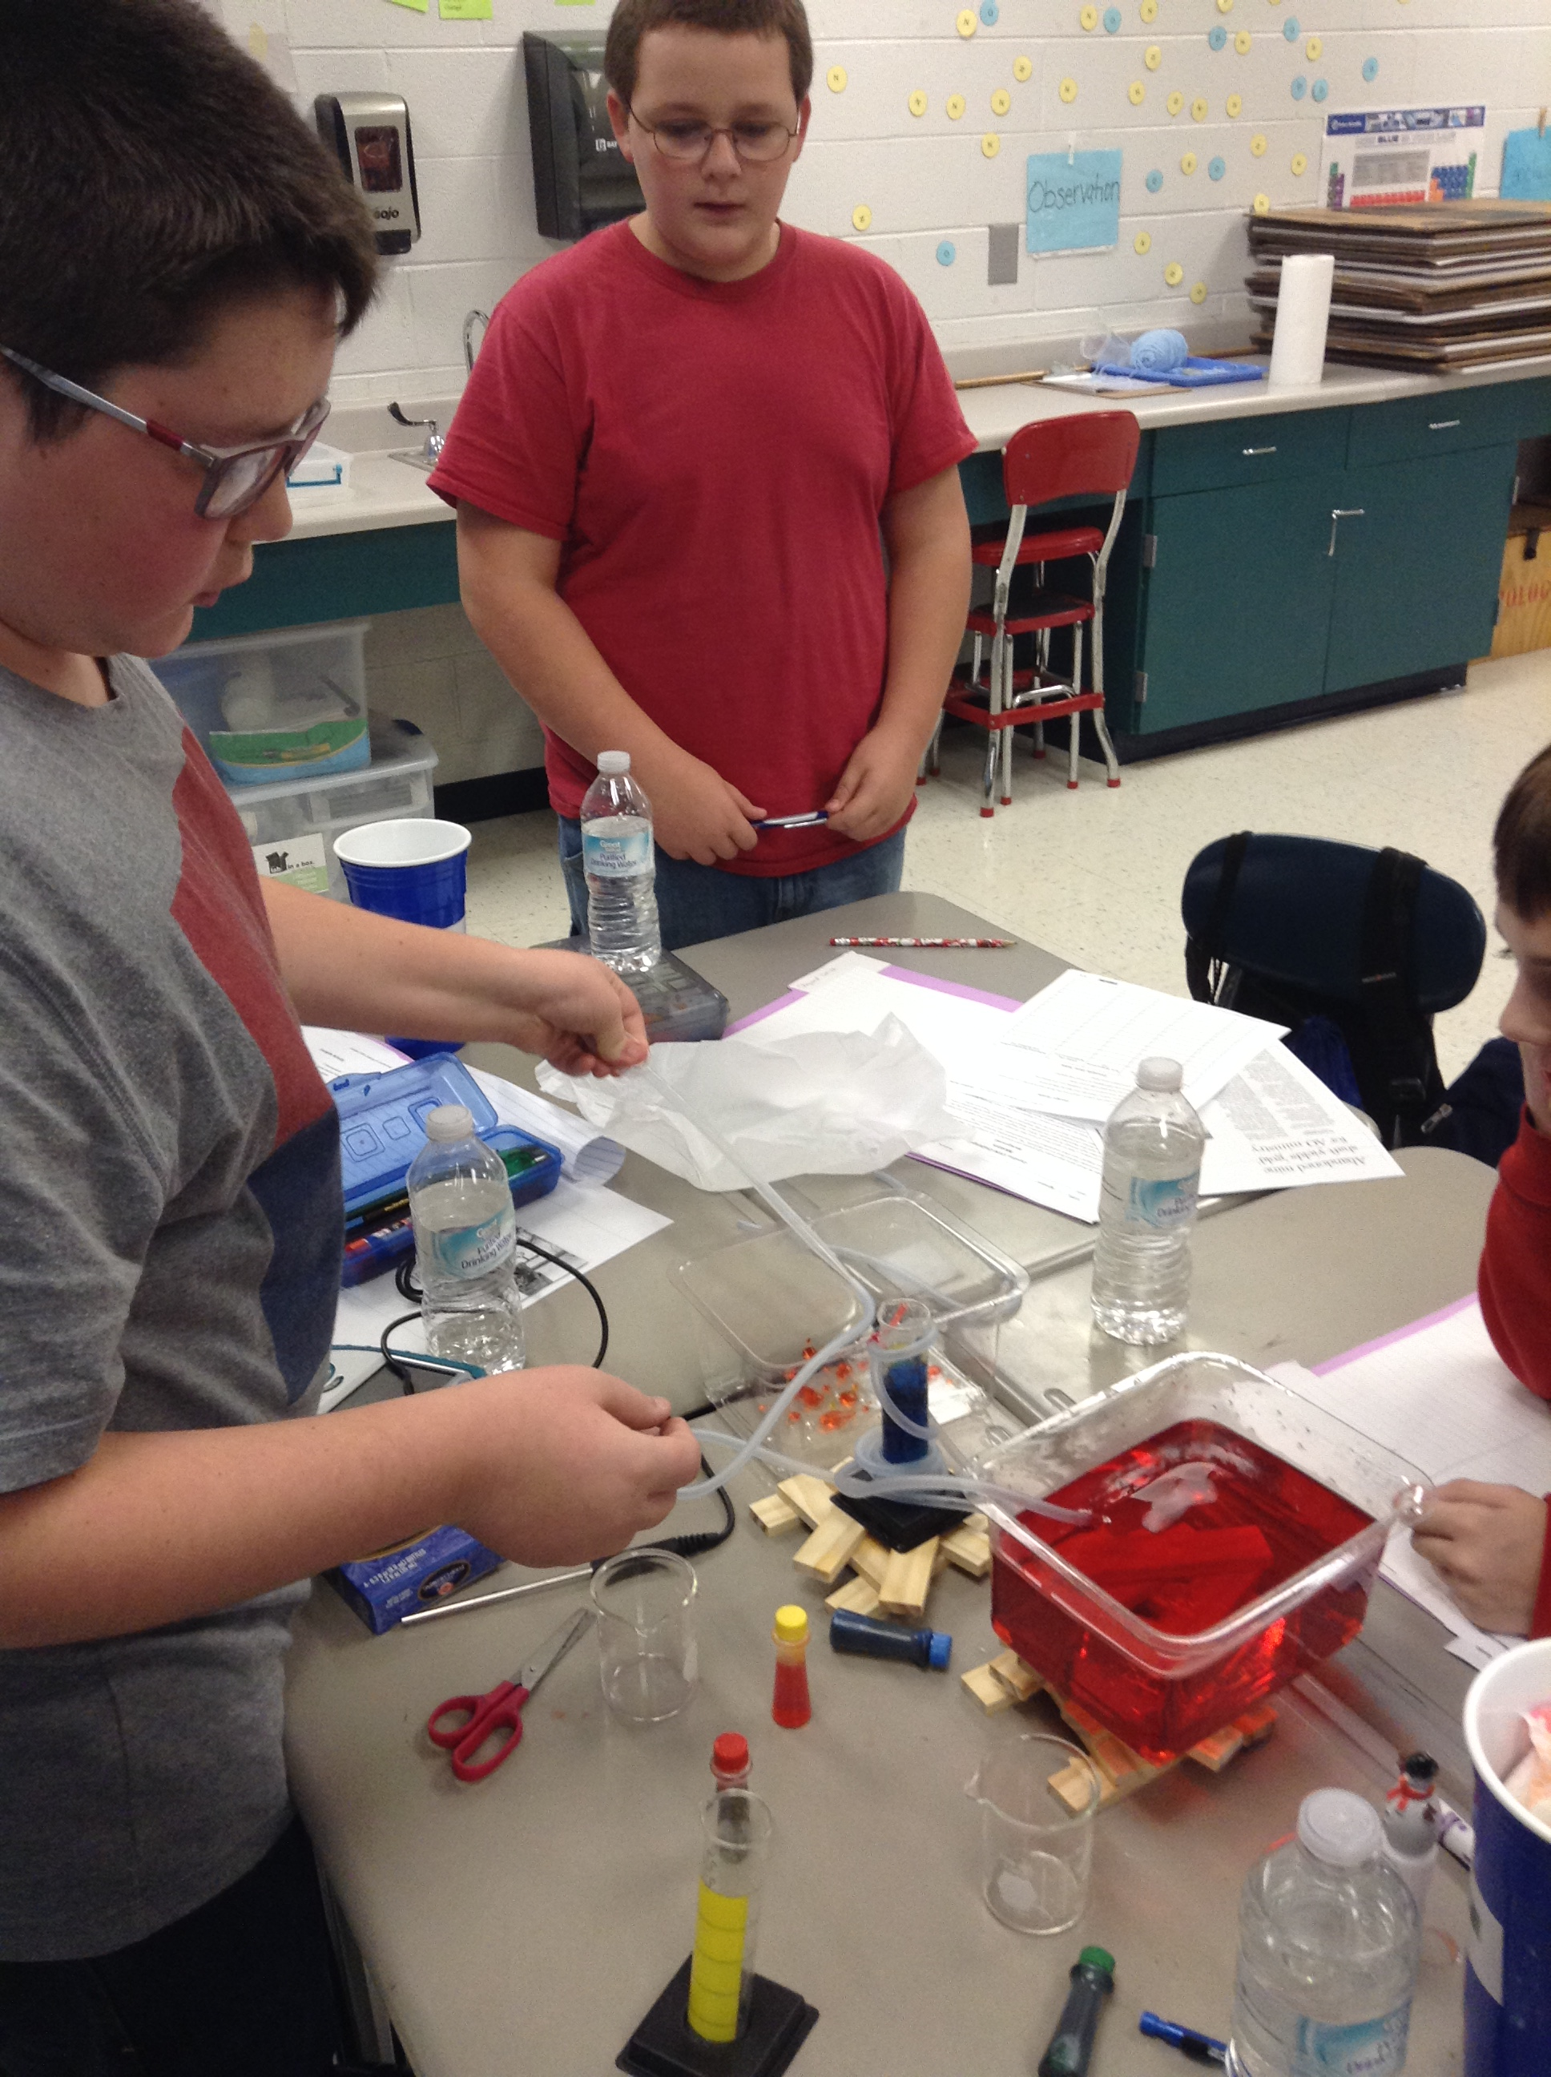
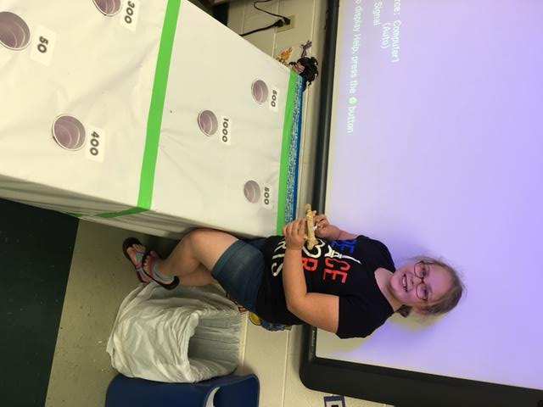
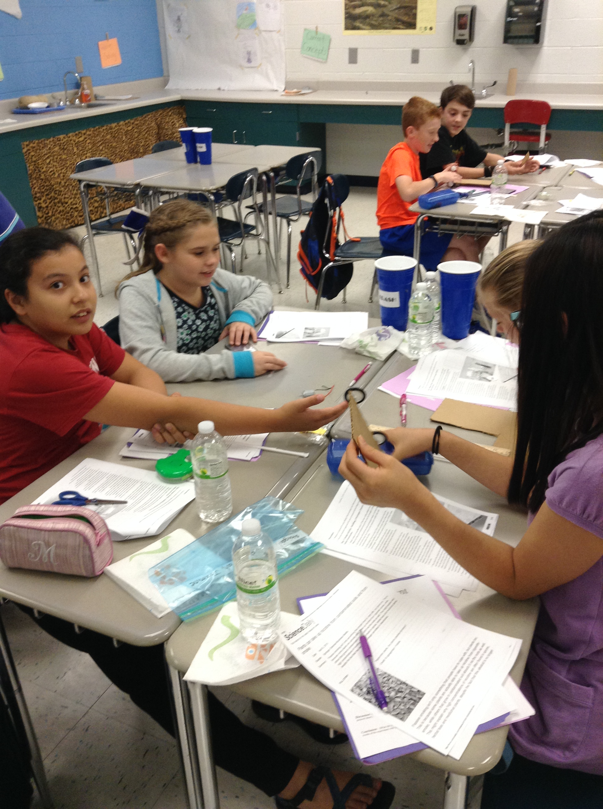
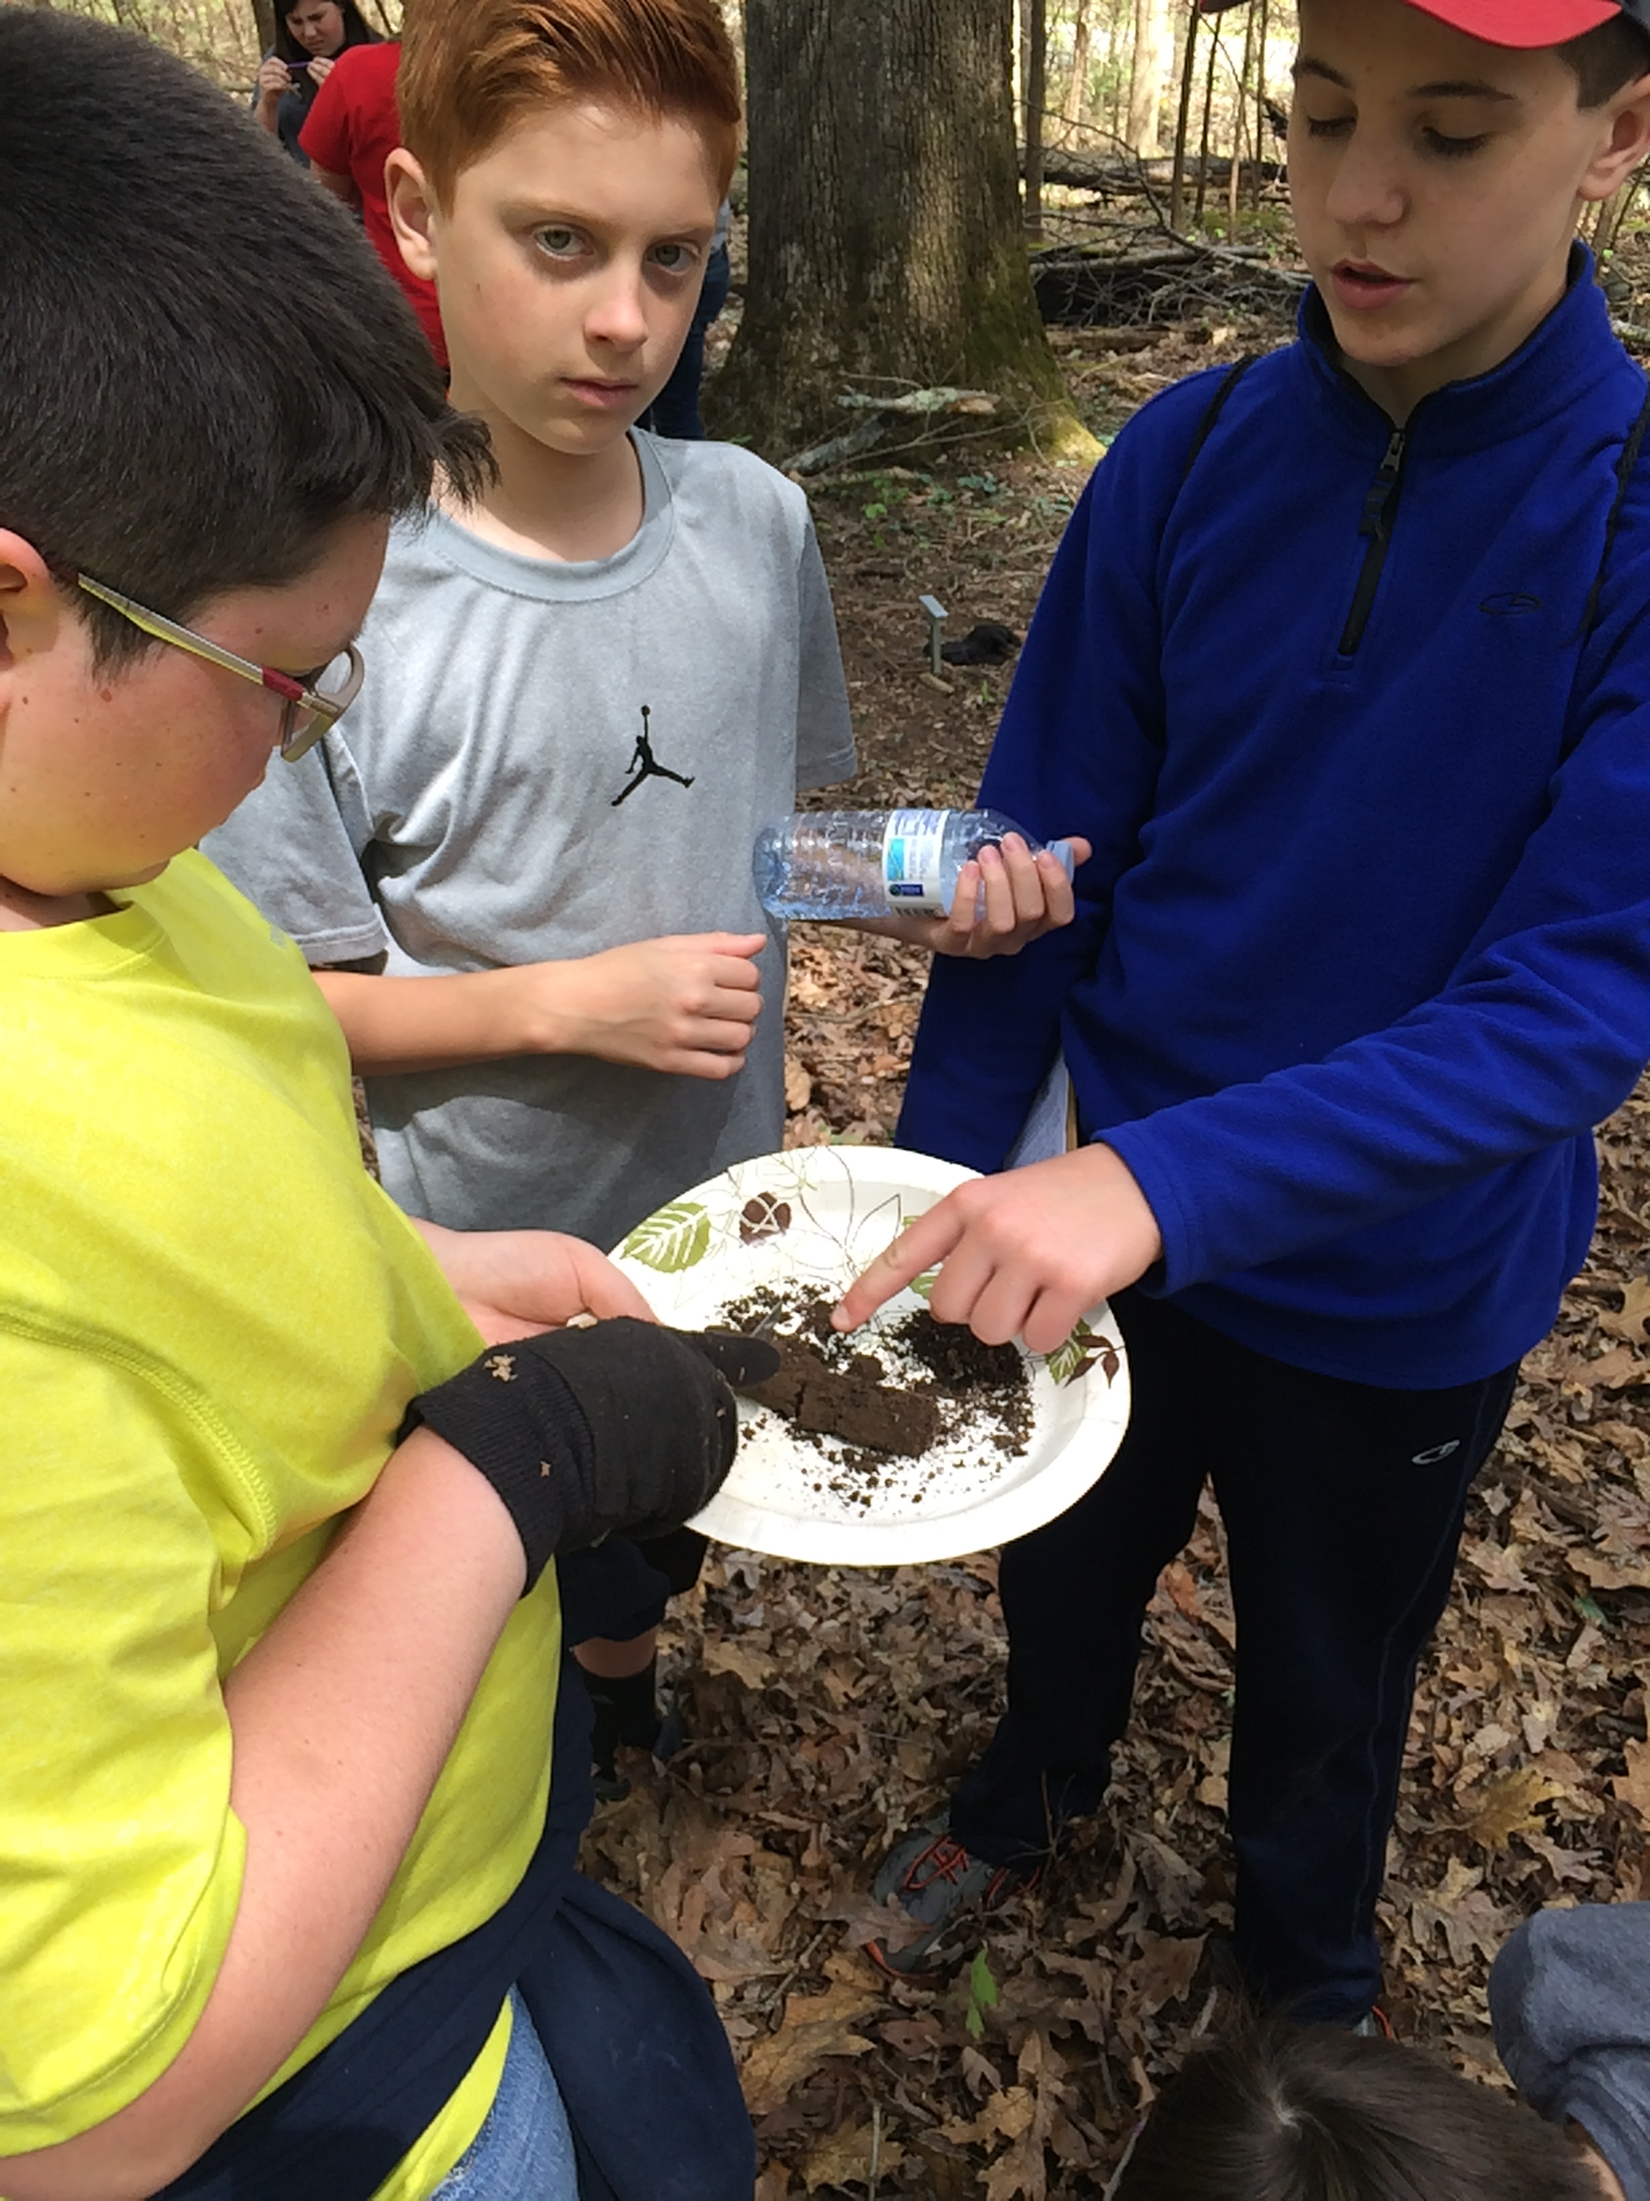
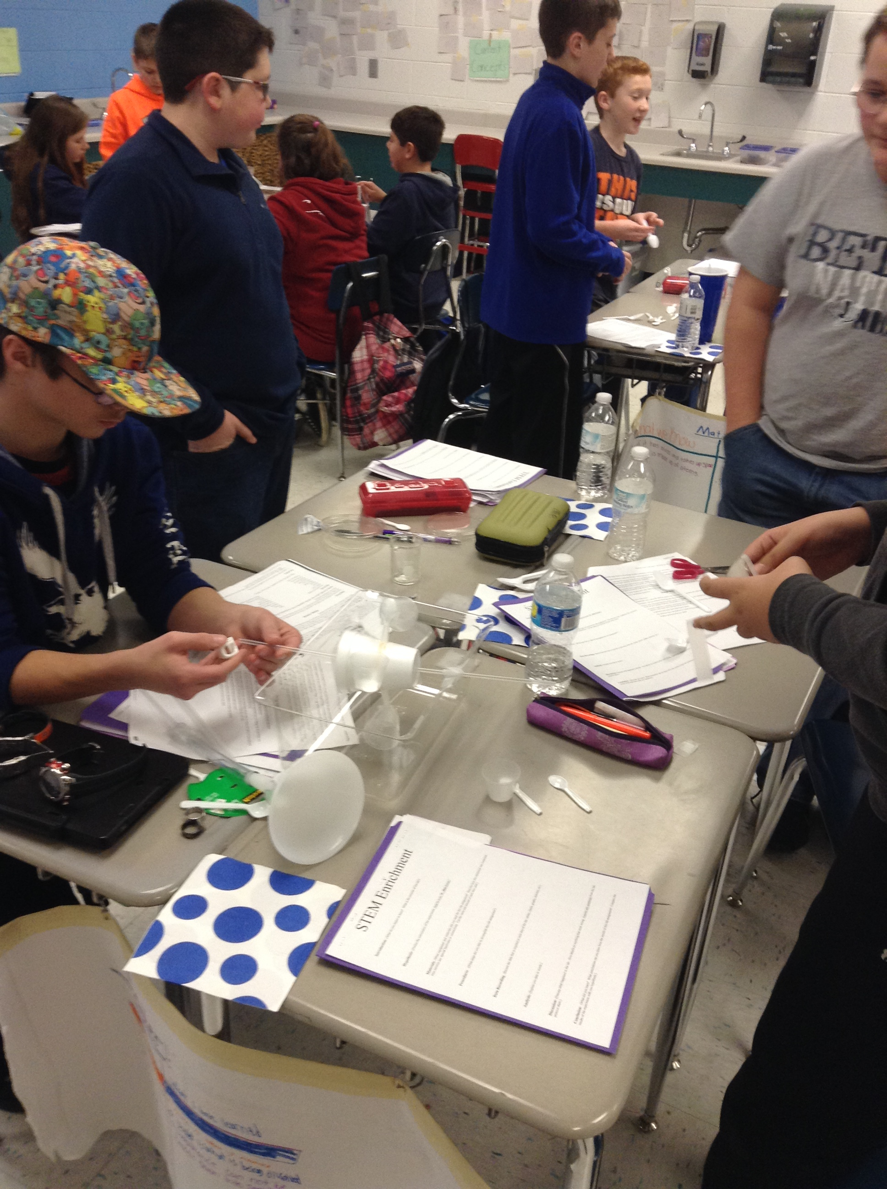
STEM Clubs

Slide 42
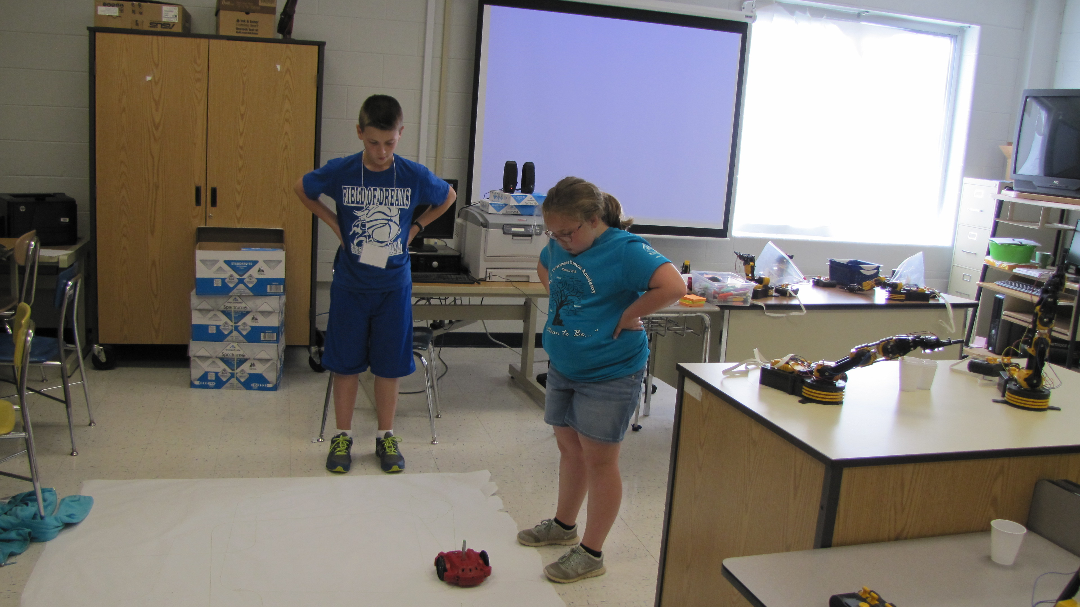
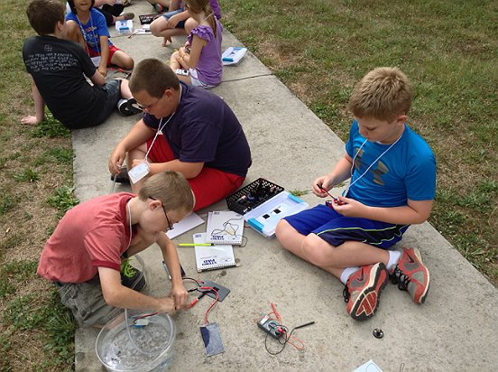
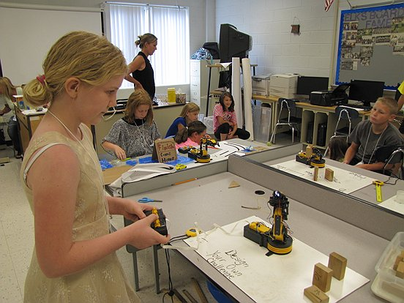
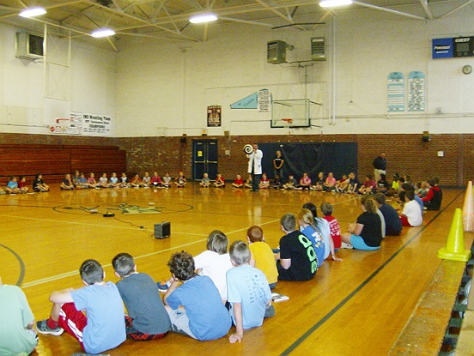
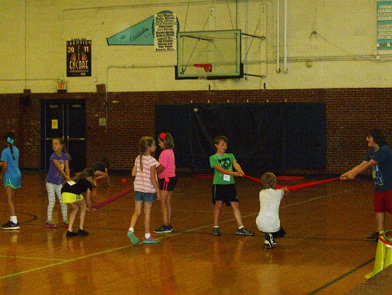
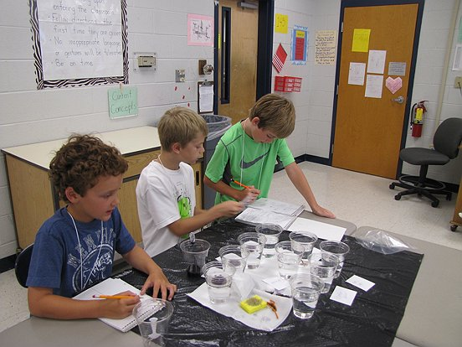
STEM Camp

Slide 43
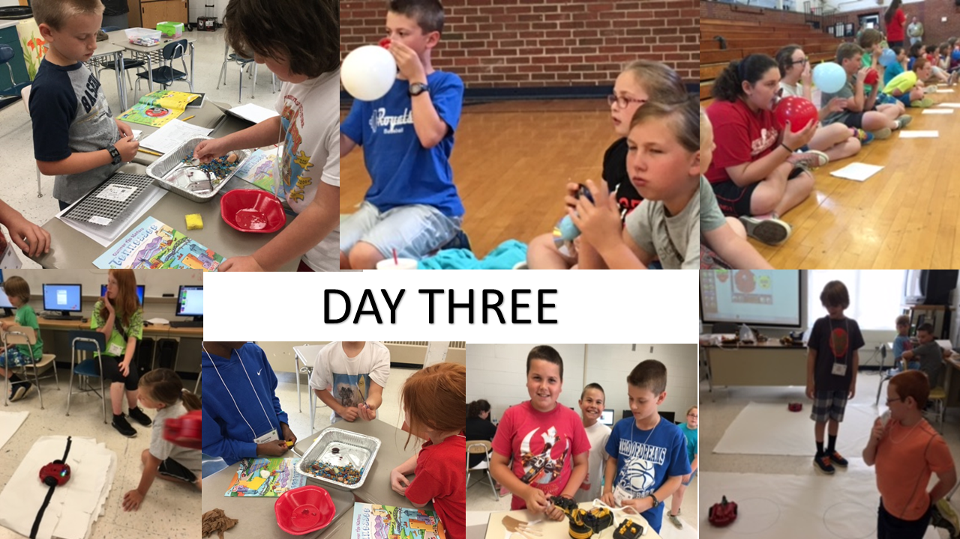
STEM Camp

