Slide 1
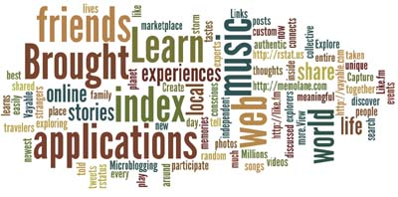
TETC 2015
Jan Coley
Jefferson County Schools
http://jc-schools.net

Slide 2
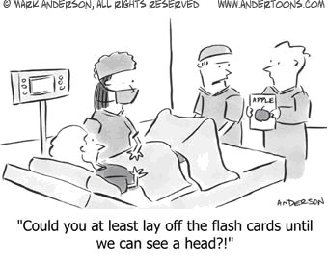

Slide 3
Fish is Fish
By: Leo Lionni:

Slide 4
Learning Pyramid

Slide 5
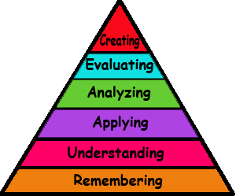
New Blooms
Source: http://www.odu.edu/educ/roverbau/Bloom/blooms_taxonomy.htm
Notes:
Remembering: can the student recall or remember the information?
Assessment: define, duplicate, list, memorize, recall, repeat, reproduce state
Understanding: Can the student explain ideas or concepts?
Assessment: classify, describe, discuss, explain, identify, locate, recognize, report, select, translate, paraphrase
Applying: Can the student use the information in a new way?
Assessment: choose, demonstrate, dramatize, employ, illustrate, interpret, operate, schedule, sketch, solve, use, write
Analyzing: Can the student distinguish between the different parts?
Assessment: appraise, compare, contrast, criticize, differentiate, discriminate, distinguish, examine, experiment, question, test
Evaluating: can the student justify a stand or decision?
Assessment: appraise, argue, defend, judge, select, support, value, evaluate
Creating: Can the student create new product or point of view?
Assessment: assemble, construct, create, design, develop, formulate, write
Source: http://www.odu.edu/educ/roverbau/Bloom/blooms_taxonomy.htm

Slide 6
TN Standards App
Android or IOS
State standards for core subjects
SPI only
Great for quick reference

Slide 7
Google Forms for Educators
Getting to Know You
Snowflake Quiz
Parent Teacher Conferences
Grading with Flubaroo

Slide 8
Kahoot
What is Kahoot?
Free
Makes learning fun
Best in group or classroom environment
Multiple choice questions
Competition
Students use own devices

Slide 9
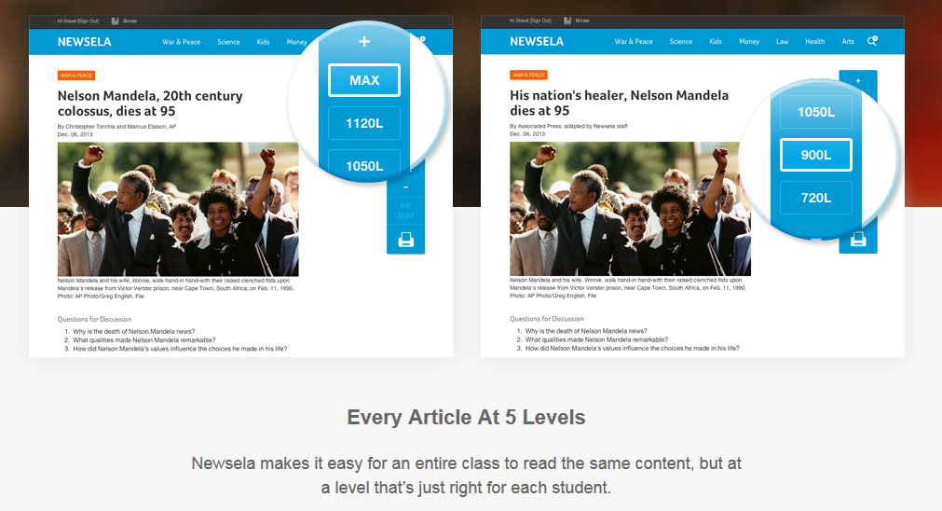
Newsela

Slide 10
Video series
Professional Development
Lesson Plans
Interactives
News and Blog

Slide 11
EDpuzzle

Slide 12
Crash Course
A YouTube channel with courses in World History, Biology, Literature, Ecology, Chemistry, Psychology, and US History.
PLUS

Slide 13
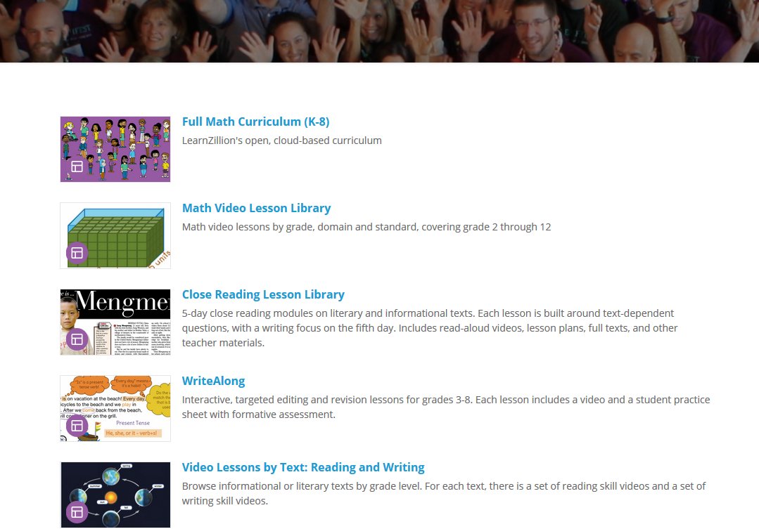
Learn Zillion

Slide 14
Edulastic
Formative Assessment tool
Free
Track student progress
Quick and easy
Training hub with video instruction for teachers
Webinars
30+ question types including drag and drop
Tutorial Edulastic Features

Slide 15
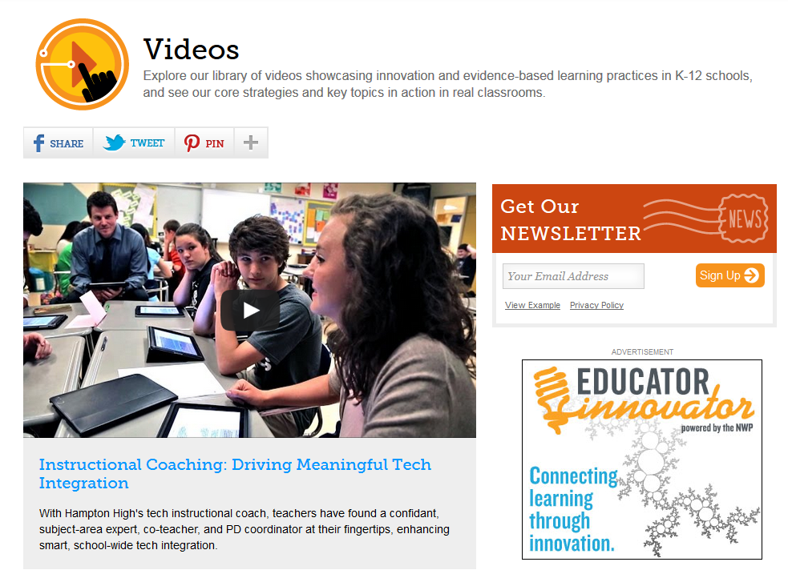
Edutopia videos

Slide 16
The Teaching Channel Videos, common Core Resources and Lesson Plans
Sample

Slide 17
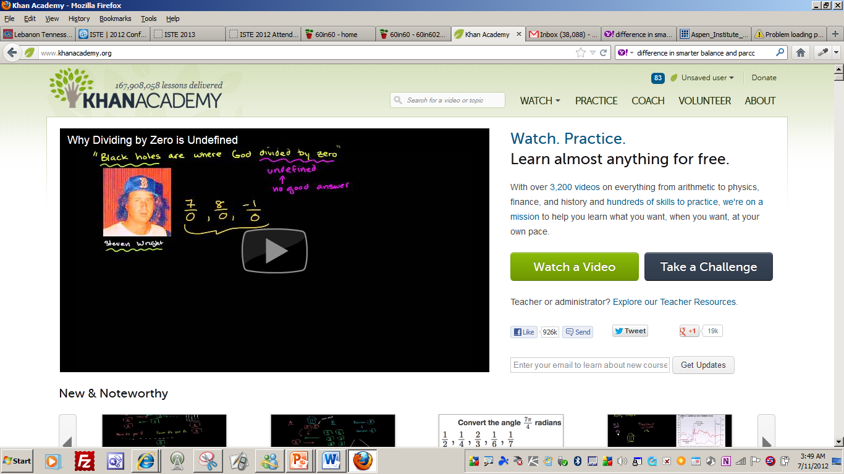
Content Resources
Khan Academy Gates Notes

Slide 18
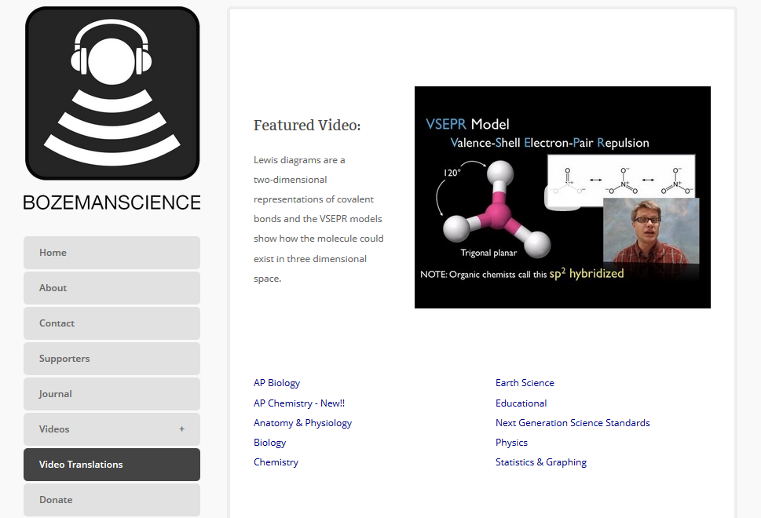
Strategies
Bozeman Science

Slide 19
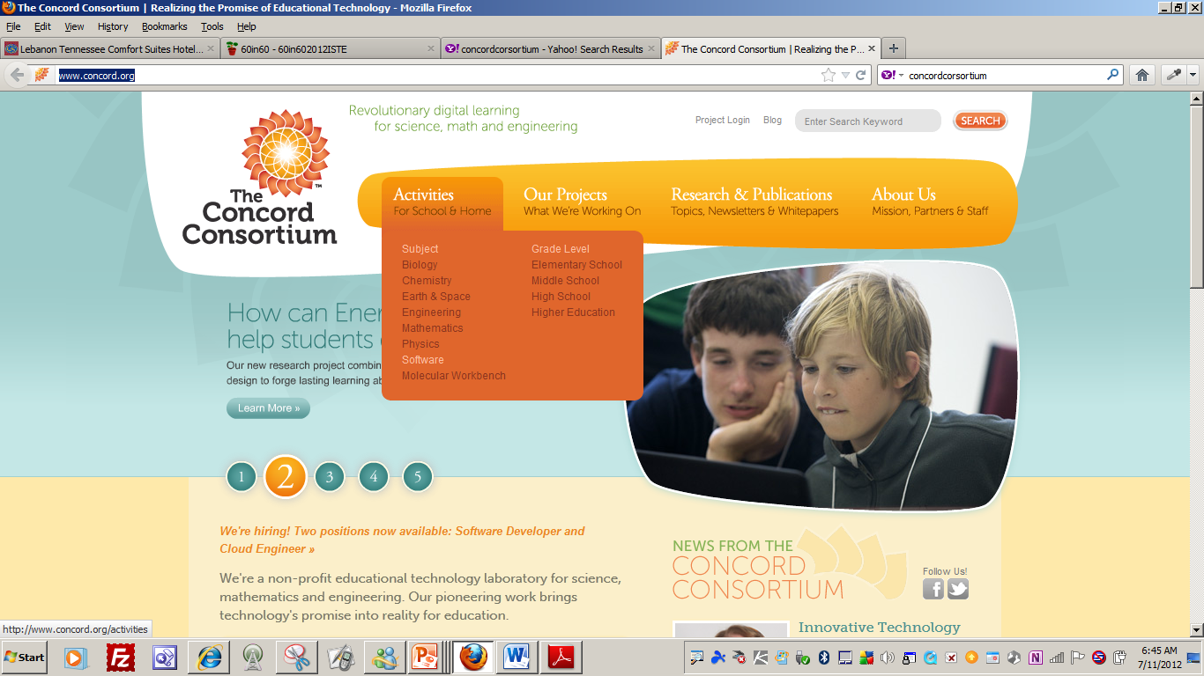
Analysis
Concord Consortium
Diffusion
STEM Resource Finder

Slide 20
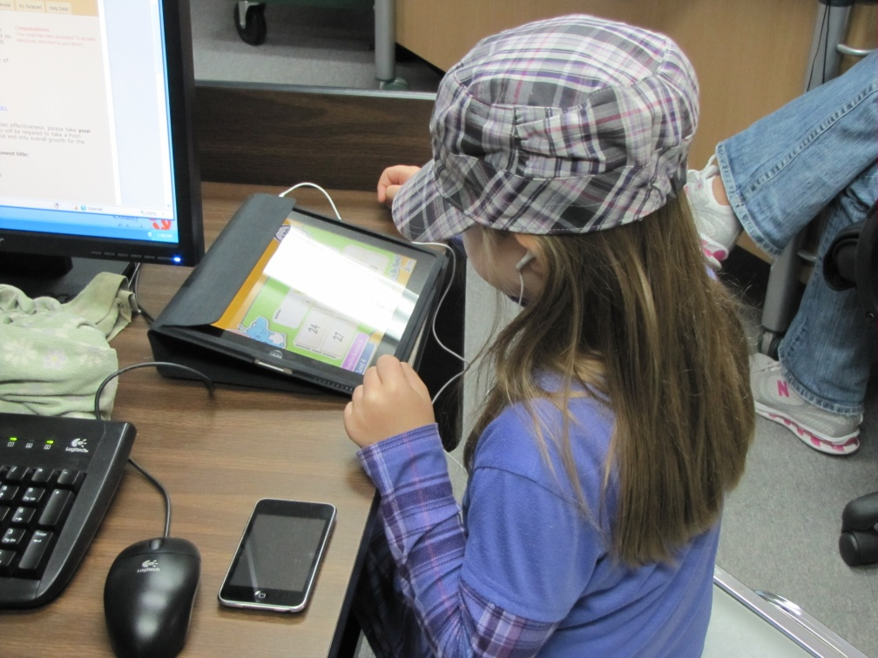
Use Tools that Engage Your Students

Slide 21
RESOURCES TO SUPPLEMENT AND ENRICH LESSONS
Science 360
NBC LEARN

Slide 22
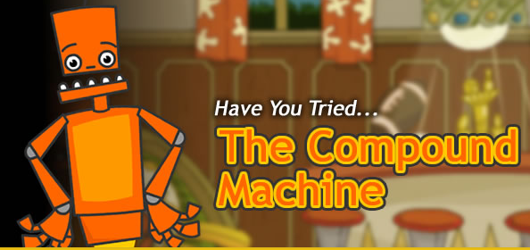
Learning Games (Experiences) with Real World Connections
CSI – The Experience
Nobelprize.org - These games and simulations, based on Nobel Prize-awarded achievements, will teach and inspire you while you’re having FUN!
TryEngineering
Edheads

Slide 23
Free Tools for Educators
See the calculator in action

Slide 24
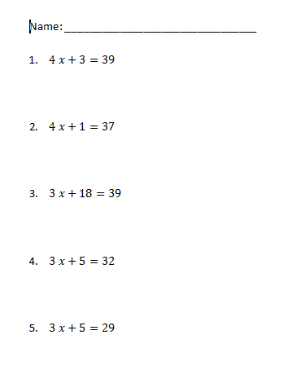
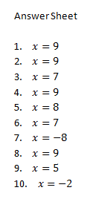
Math Worksheet Generator

Slide 25
Strategies
SWAY
Create and share interactive content in minutes!

Slide 26
Strategies
AutoCollage
Photo collages celebrate important events and themes in our lives. Pick a folder, press a button, and in a few minutes AutoCollage presents you with a unique memento to print, email, or include in a digital project.

Slide 27
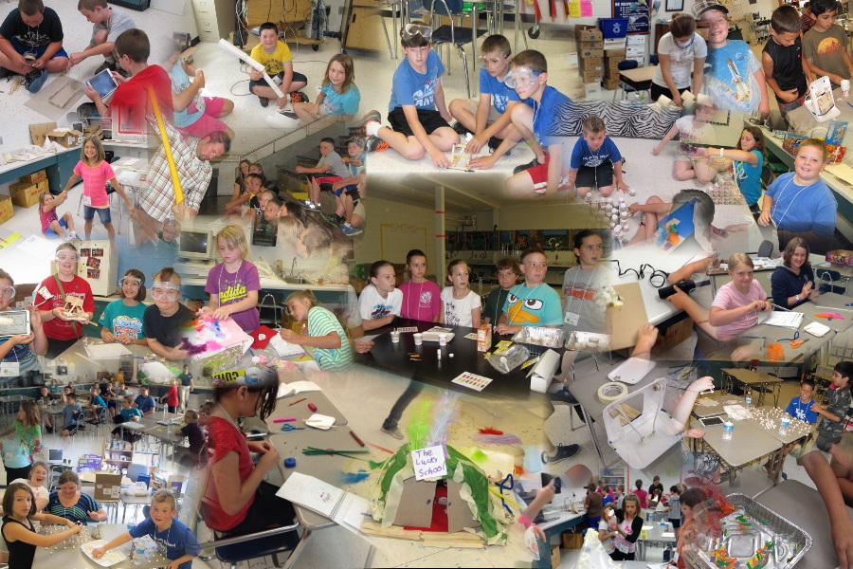
STEM Education

Slide 28
Buck Institute

Slide 29
Tennessee Opportunity Programs, Inc. (TOPS) is a private non-profit agency chartered in 1973 in the State of Tennessee.

Slide 30
HHMI
VIRTUAL LABS

Slide 31
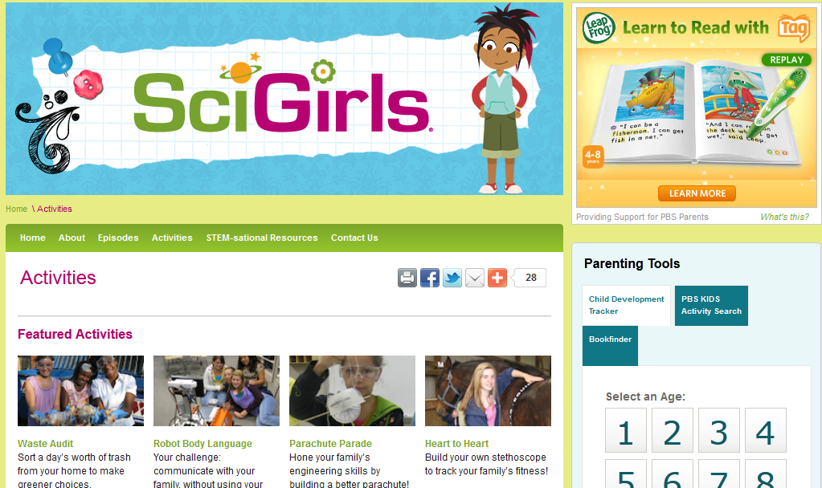
SciGirls (from PBS)

Slide 32
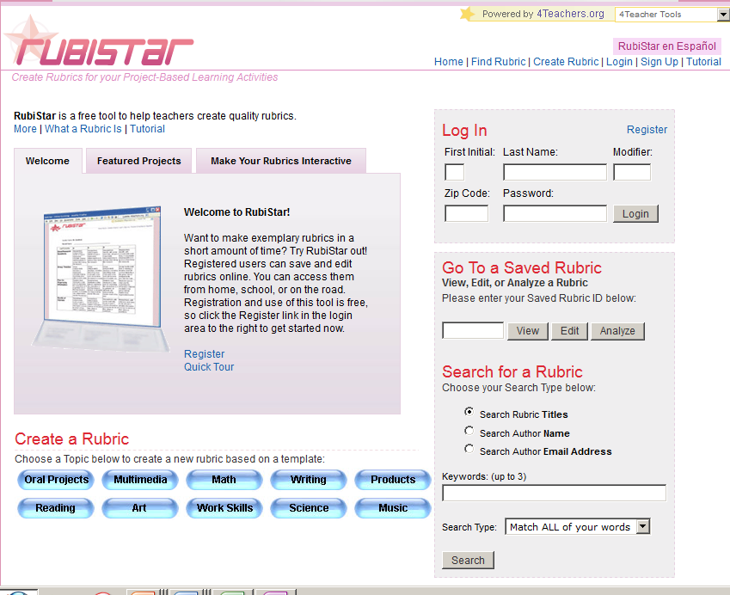
Rubistar
Assessment
Tools

Slide 33
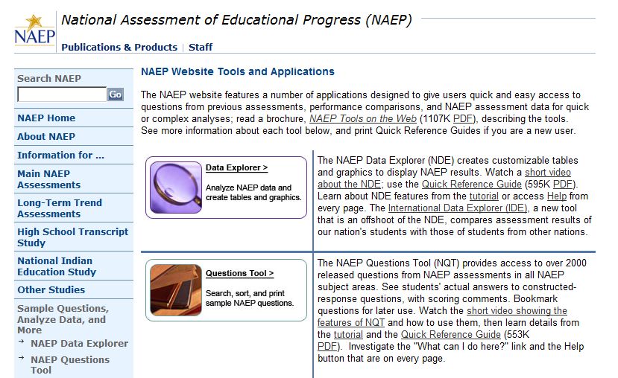
Assessment Tools
NAEP Questioning Tool
Users Guide
Example

Slide 34
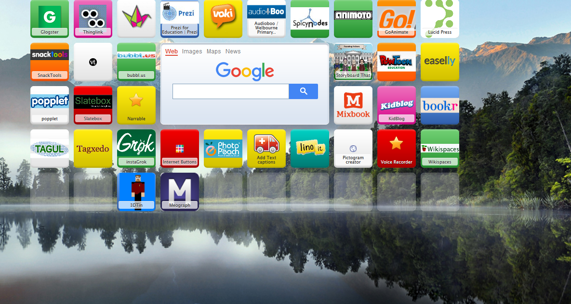
Symbaloo

Slide 35
Comic Creator http://www.readwritethink.org/files/resources/interactives/comic/index.html

Slide 36
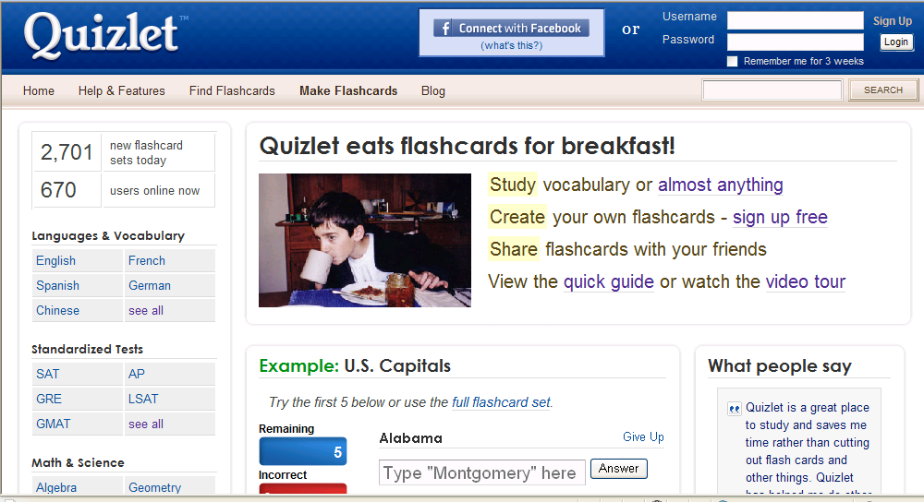
Quizlet quizlet.com (Web 2.0)
TN 6th grade science academic vocabulary

Slide 37
Quizlet

Slide 38
Utah Education Network – Student Interactives

Slide 39
Utah Education Network – Student Interactives

Slide 40
Bubbl.us http://bubbl.us/
Create mind maps consisting of a number of interconnected Bubbles containing text
Entirely browser based editor
User can control the size, color and arrangement
Bubbles can be cross-connected
Other users can collaborate on mind maps
Easily shared or embedded in the user's website

Slide 41
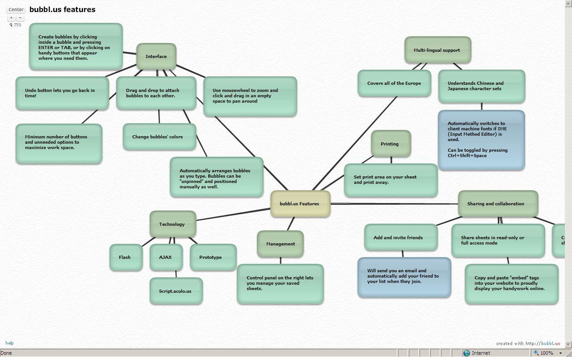

Slide 42
Seven Ways to use Mind Maps in the Classroom http://www.thinkbuzan.com/us/articles/view/7-mind-mapping-uses-for-teaching
Lesson Preparation
Delivering lessons
Curriculum planning
Creating Handouts
Encouraging Discussion and Independent thinking
Student Evaluation
Self Evaluation

Slide 43
Advanced Search in Google

Slide 44
p

Slide 45
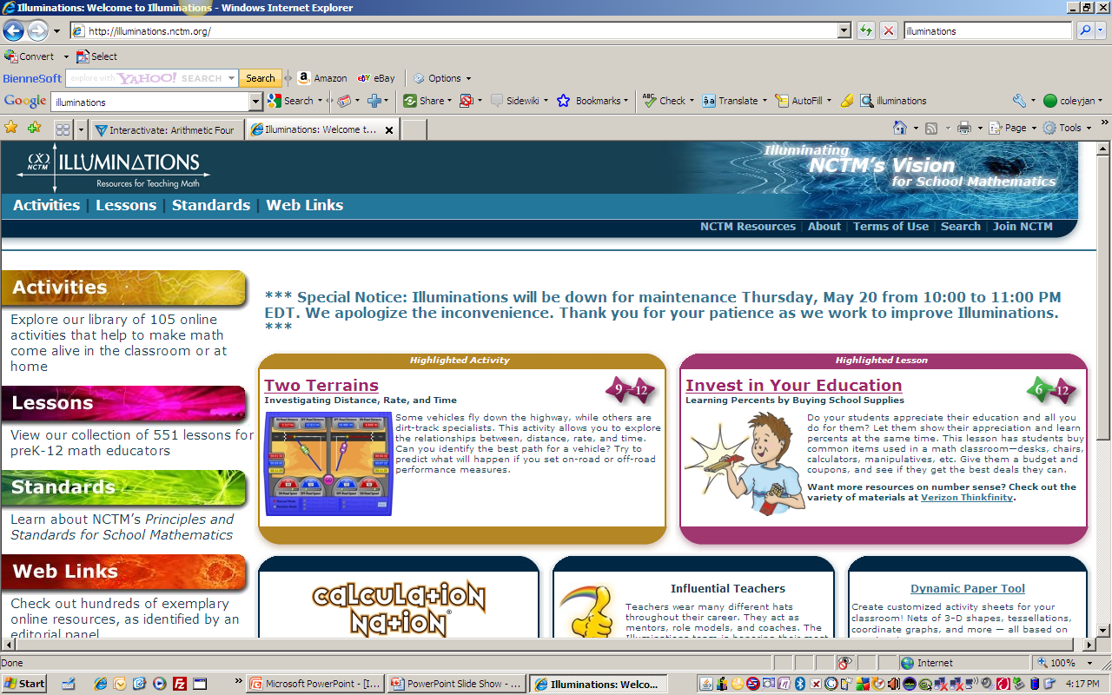
Illuminations

Slide 48
A Maths Dictionary for Kids

Slide 49
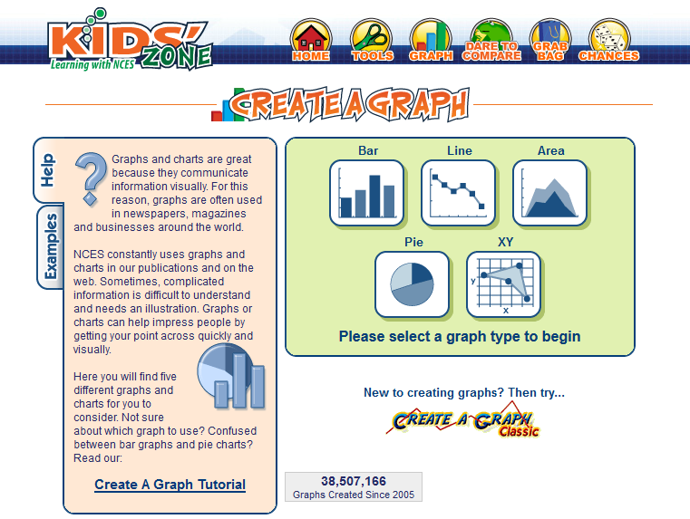
Create a Graph

Slide 50
Math Playground

Slide 52
Kid Newton

Slide 53
Exploratorium
Newspaper Bridges
Online Activities
Site includes:
Treasure Trove
Learning Resources Library from National Science Digital Library (NSDL).
Special Collections including a microscope imaging station, math explorer database, webcasts, podcasts and media downloads

Slide 54
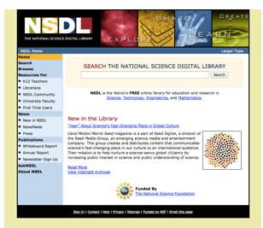
National Science Digital Library
National Science Digital Library Project Archive

Slide 55
You Are Teaching in an Age of Digital Learners

Slide 56
UNLIMITED POSSIBILITIES!

Slide 57
p
PROGRAM OVERVIEW
Sites
Participants
Dates/hours of operation
WHAT WILL YOUR LEGACY BE?

Slide 58
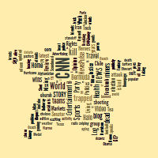
Thank You! Let digital resources make you a STAR!
Tagxedo site for creating word clouds in an image shape
Questions?

